Slide 1
Faculty Design Review
Notes:
Introduction:
List people by name and their relative role.
General notes:
Lacks punch
Break up final diagram into 11 parts with slides from Stoytchev’s stuff.
Potentially include PONG video for slide 2.

Slide 2
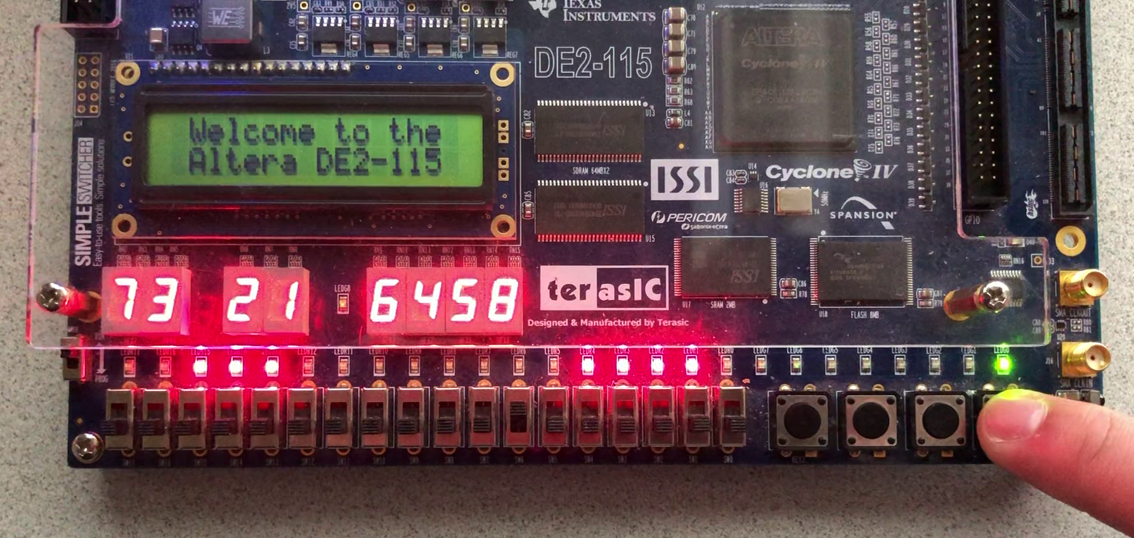
i281 CPU on a FPGA (Spring/Summer 2019)
Notes:
[Daryl]
Our project is a hardware implementation of the i281 CPU developed by Dr. Alexander Stoytchev for the CPR E 281, digital logic, class. The overarching goal for the project, as declared by the project name, is to provide a physical hardware implementation of the i281 processor without the use of an Altera board, and further, any FPGA-based platform. This implementation will make use of concepts from our classes about electronics circuit design, digital logic, and PCB design.
To outline

Slide 3
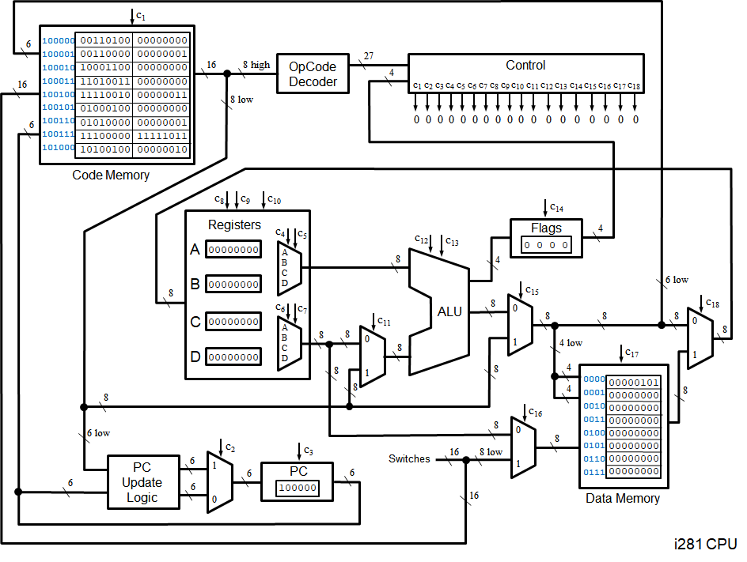
i281 CPU in CPR E 281 Slides (Fall 2019)
Notes:
[Daryl]
Our project is a hardware implementation of the i281 CPU developed by Dr. Alexander Stoytchev for the CPR E 281, digital logic, class. The overarching goal for the project, as declared by the project name, is to provide a physical hardware implementation of the i281 processor without the use of an Altera board, and further, any FPGA-based platform. This implementation will make use of concepts from our classes about electronics circuit design, digital logic, and PCB design.
To outline

Slide 4
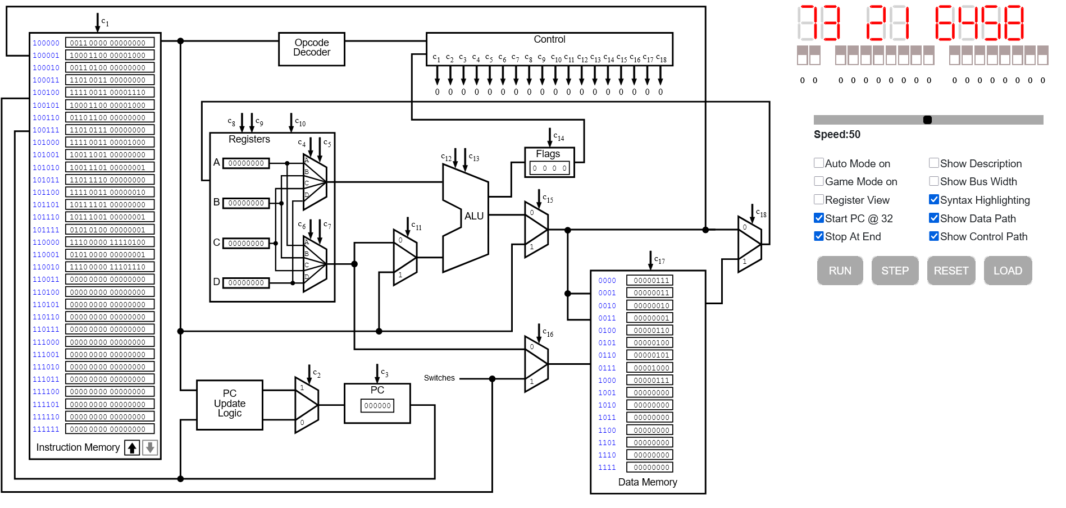
i281 Simulator (Fall 2020 / Spring 2021)
Notes:
[Daryl]
A year after the deployment of the i281 CPU in class, a senior design team was tasked with developing an online simulator of the simulator.

Slide 5
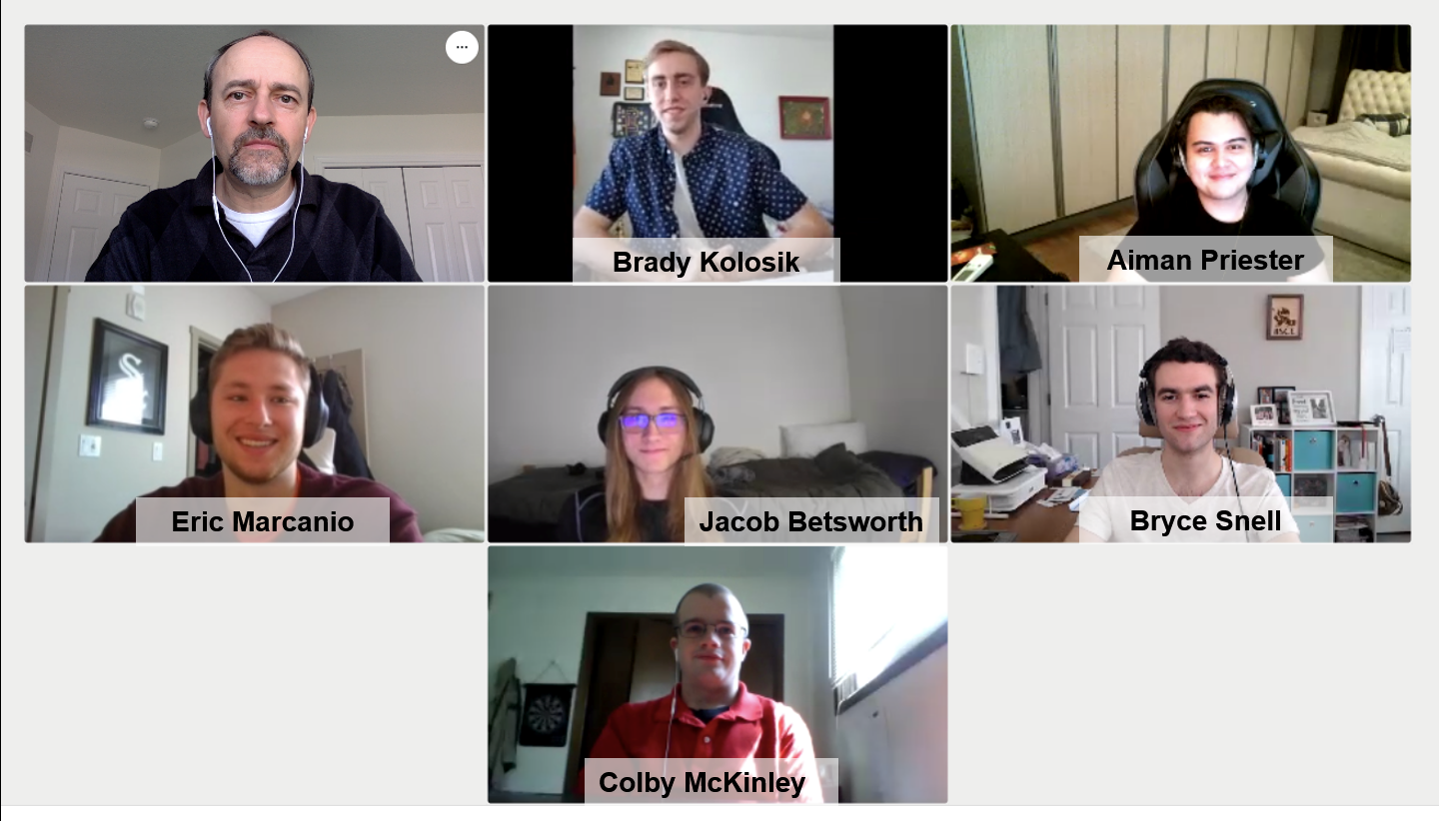
i281 Simulator (Fall 2020 / Spring 2021)
Notes:
Developed by a SD team back in Fall 2020 through Spring 2021

Slide 6
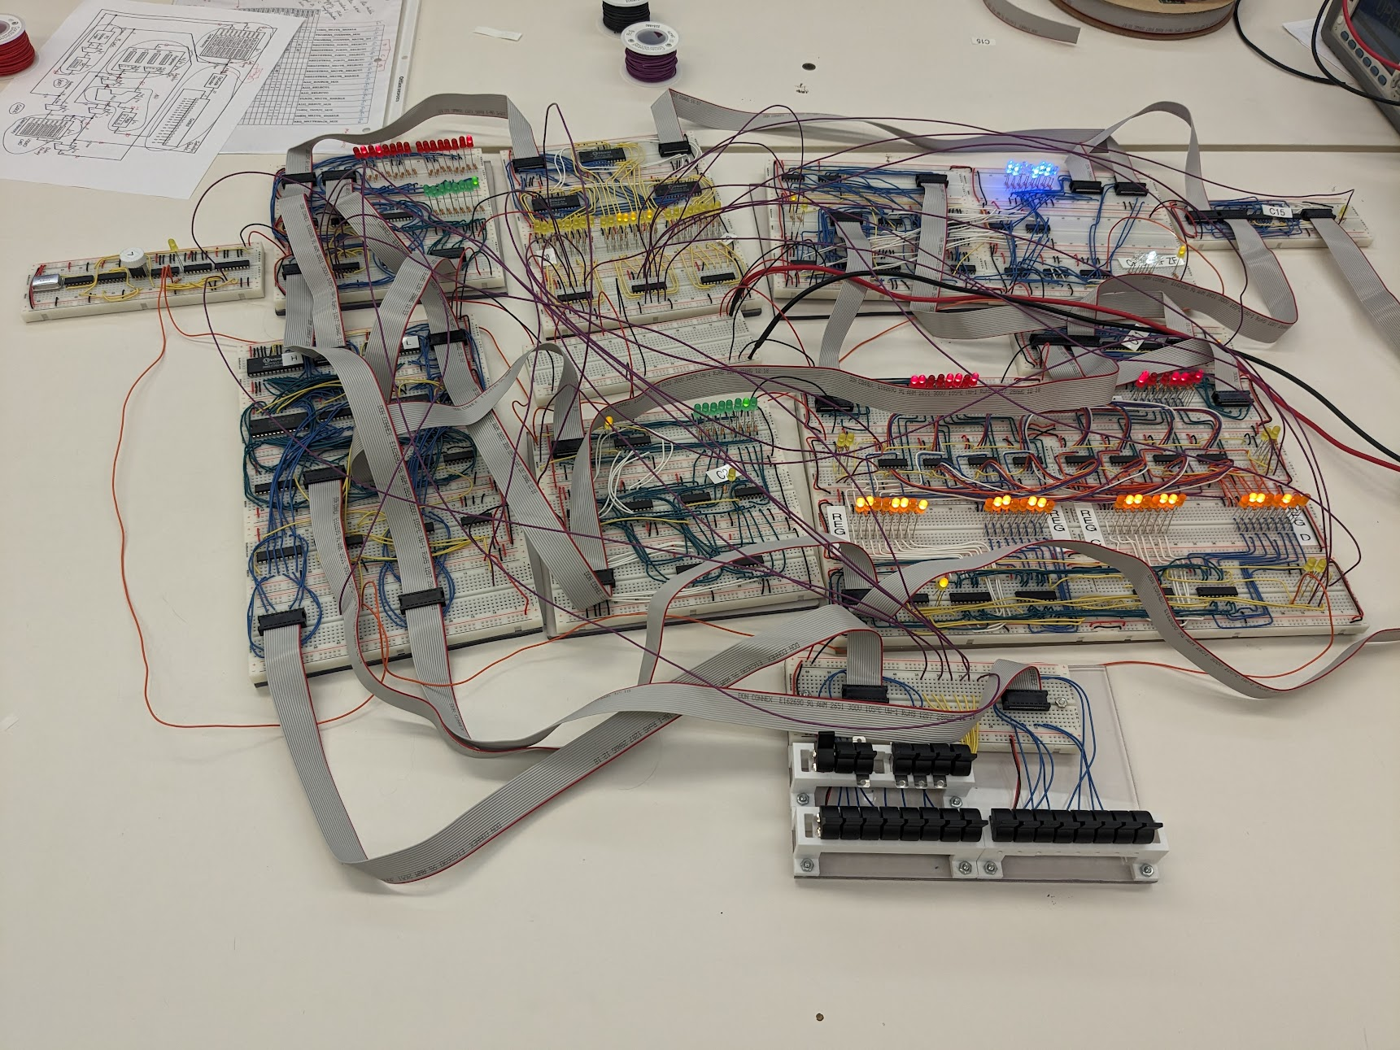
Current Project (Fall 2023 / Spring 2024)

Slide 7
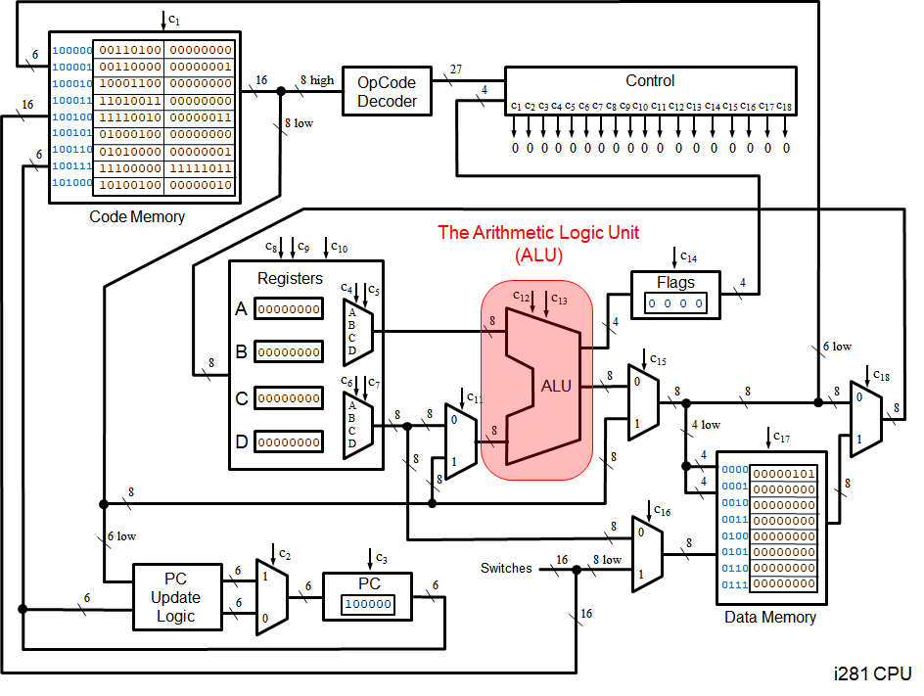

Slide 8
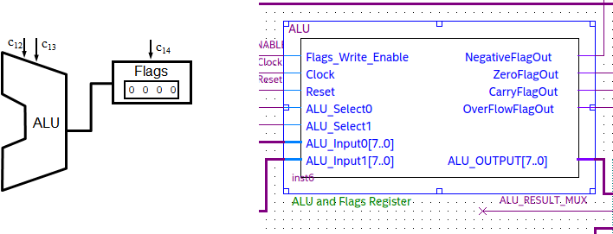
ALU FPGA Design

Slide 9
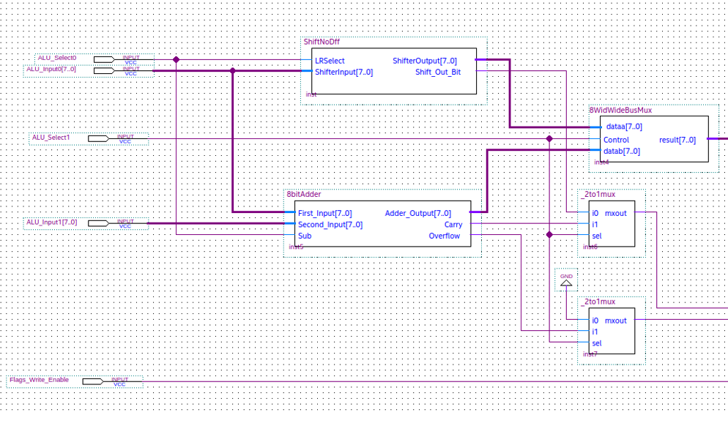
ALU Verilog

Slide 10
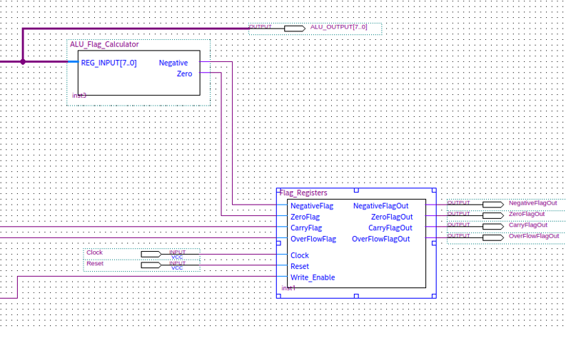
Flag Register Verilog

Slide 11
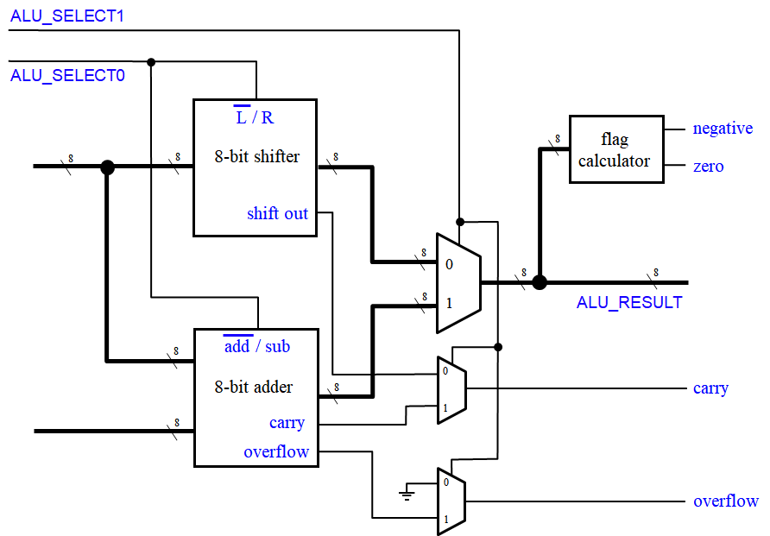
ALU Logic

Slide 12
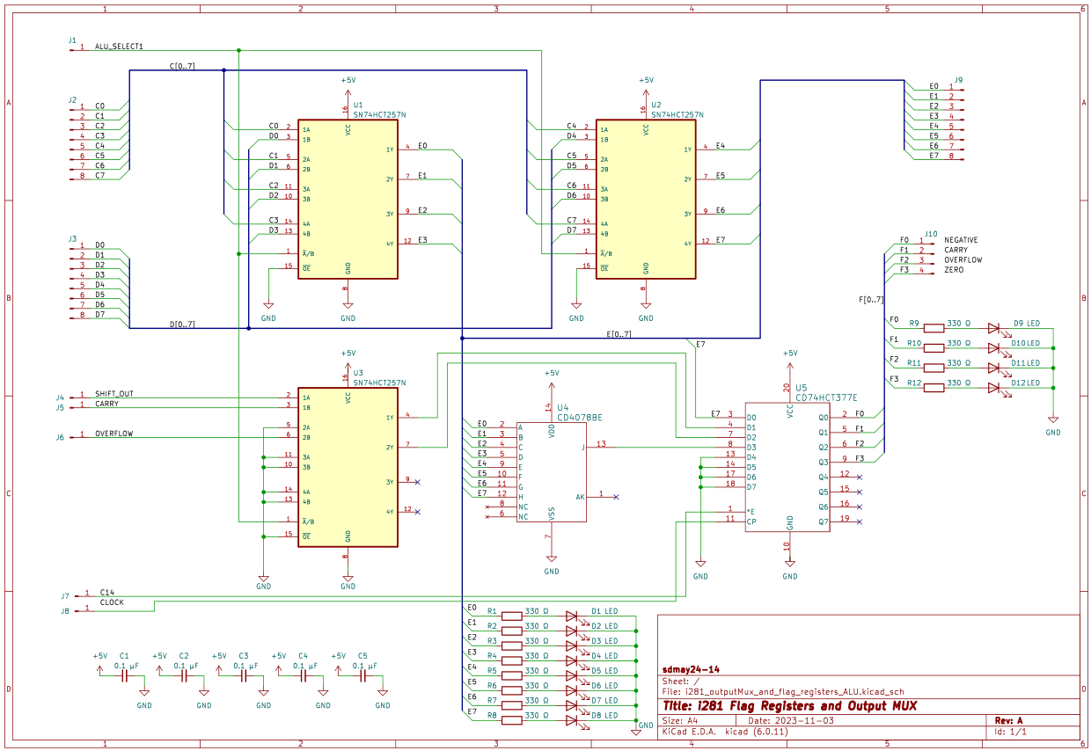
ALU Schematic (1 of 3)

Slide 13
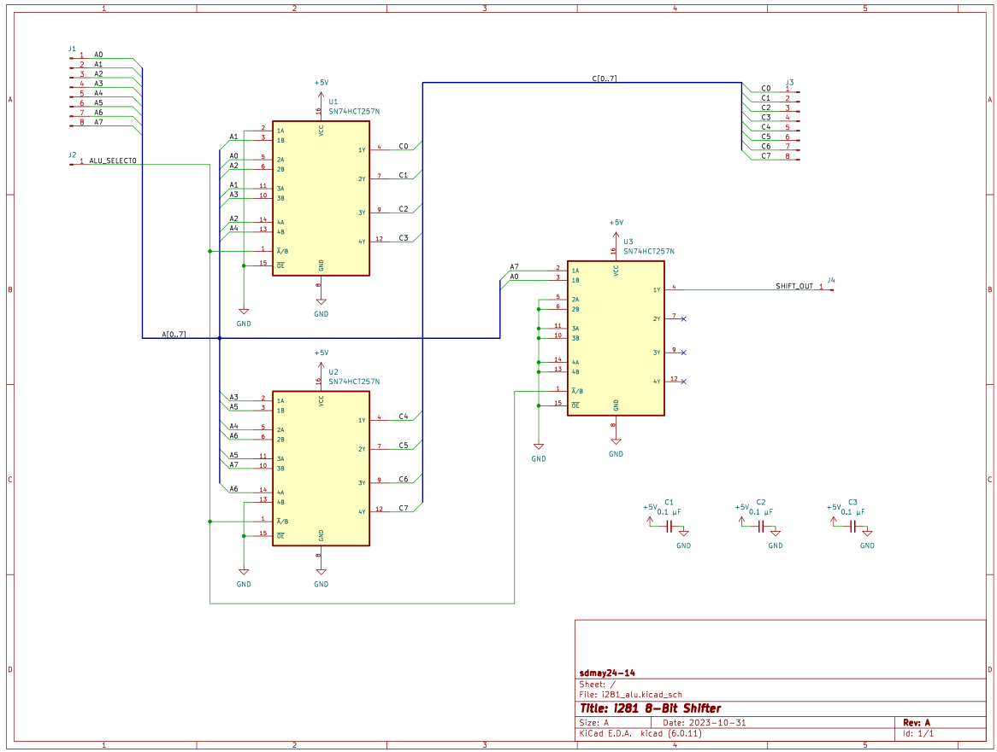
ALU Schematic (2 of 3)
Notes:
[Braxton]

Slide 14
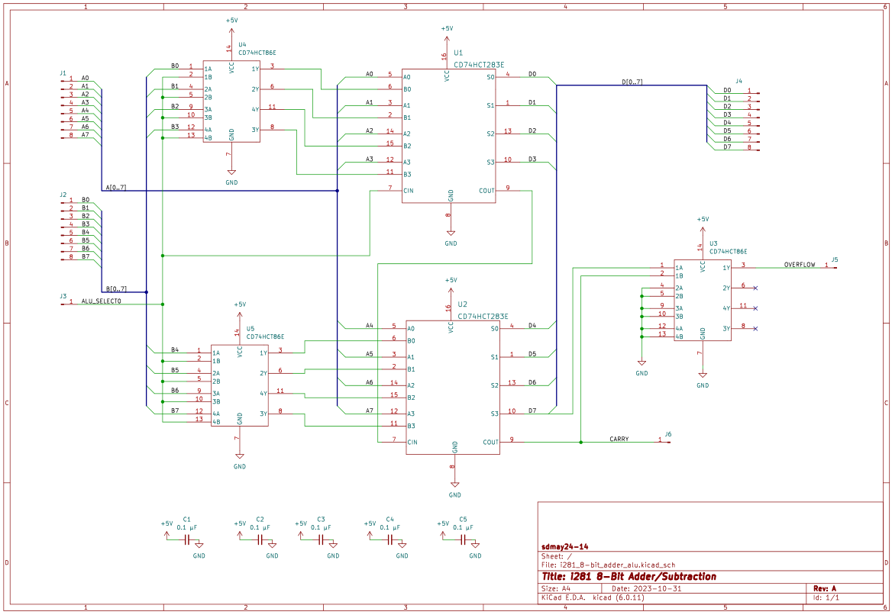
ALU Schematic (3 of 3)
Notes:
[Braxton]

Slide 15
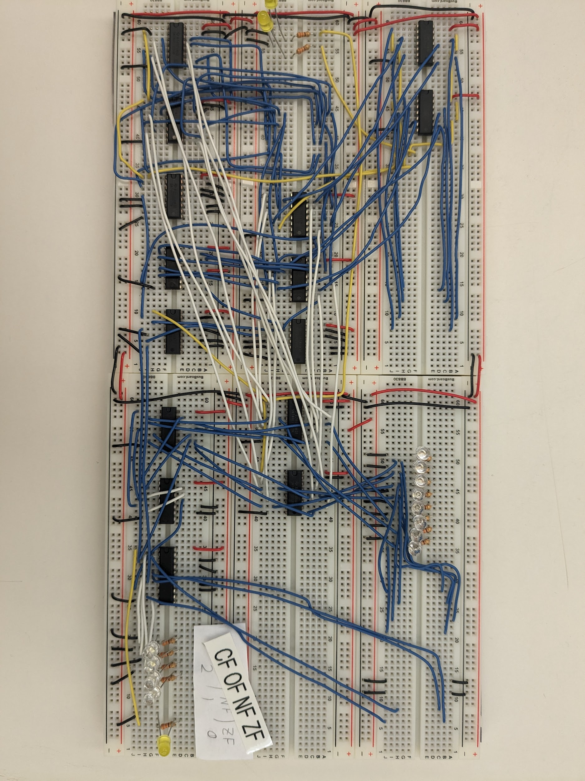
ALU Implementation
Notes:
[Braxton]

Slide 16
Where’s ALU?
ALU
Notes:
[Braxton]

Slide 17
All the Modules
Decoder
ALU
MUX
Clock
MUX
Code Memory
Program Counter
Registers
Switches

Slide 18
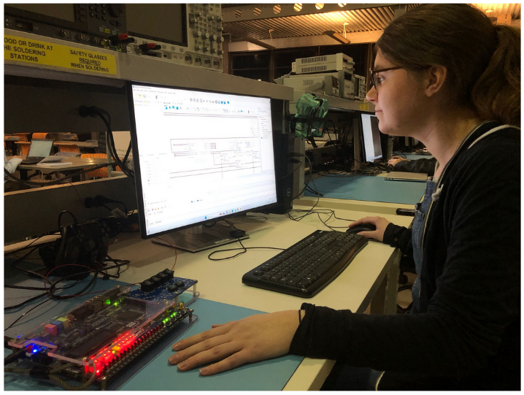
Project Vision
Notes:
[Daryl]
Our primary vision for this project is to be used as an extended teaching tool for CPR E 281 to better physically and visually represent the operations of the processor. As seen with the Altera board, internal registers and calculations weren’t visible for students to view and the online simulator is pure software lacking a physical device to tactilely interact upon. Students would benefit greatly with a more detailed examination of the internal workings of the processor.
To accomplish this vision, we need to discuss our requirements.

Slide 19
Project Vision
Notes:
[Daryl]
Our primary vision for this project is to be used as an extended teaching tool for CPR E 281 to better physically and visually represent the operations of the processor. As seen with the Altera board, internal registers and calculations weren’t visible for students to view and the online simulator is pure software lacking a physical device to tactilely interact upon. Students would benefit greatly with a more detailed examination of the internal workings of the processor.
To accomplish this vision, we need to discuss our requirements.

Slide 20
Project Vision
Notes:
[Daryl]
Our primary vision for this project is to be used as an extended teaching tool for CPR E 281 to better physically and visually represent the operations of the processor. As seen with the Altera board, internal registers and calculations weren’t visible for students to view and the online simulator is pure software lacking a physical device to tactilely interact upon. Students would benefit greatly with a more detailed examination of the internal workings of the processor.
To accomplish this vision, we need to discuss our requirements.

Slide 21
Project Vision
Notes:
[Daryl]
Our primary vision for this project is to be used as an extended teaching tool for CPR E 281 to better physically and visually represent the operations of the processor. As seen with the Altera board, internal registers and calculations weren’t visible for students to view and the online simulator is pure software lacking a physical device to tactilely interact upon. Students would benefit greatly with a more detailed examination of the internal workings of the processor.
To accomplish this vision, we need to discuss our requirements.

Slide 22
Project Vision
Notes:
[Daryl]
Our primary vision for this project is to be used as an extended teaching tool for CPR E 281 to better physically and visually represent the operations of the processor. As seen with the Altera board, internal registers and calculations weren’t visible for students to view and the online simulator is pure software lacking a physical device to tactilely interact upon. Students would benefit greatly with a more detailed examination of the internal workings of the processor.
To accomplish this vision, we need to discuss our requirements.

Slide 23
Requirements Summary
CPU must be explainable to CPR E 281 students
All internal storage and calculations must be visualized through LEDs
CPU clock must permit stepping through instructions and operating at a specific range of frequencies
CPU must be capable of playing a version of i281 PONG example program and allow for custom programs via switches
CPU design must be as close as possible to the original Verilog design
Notes:
[Braxton]
NOTE: Might need to redo the notes below. Whomever takes this section should verify.
Used as a teaching tool
Use LEDs for visualization and learning
Clock frequency can be run from 1 MHz all the way through single step
Capable of running pong and other programs
Still have the i281 identity, similar to original verilog

Slide 24
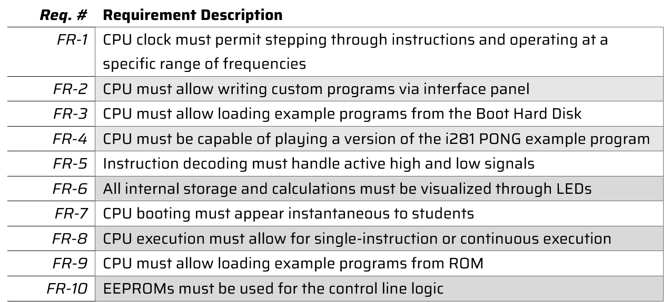
Functional Requirements
Notes:
[Braxton] Functional, qualitative, quantitative, and constraints
Were able to separate them and make them more concrete

Slide 25
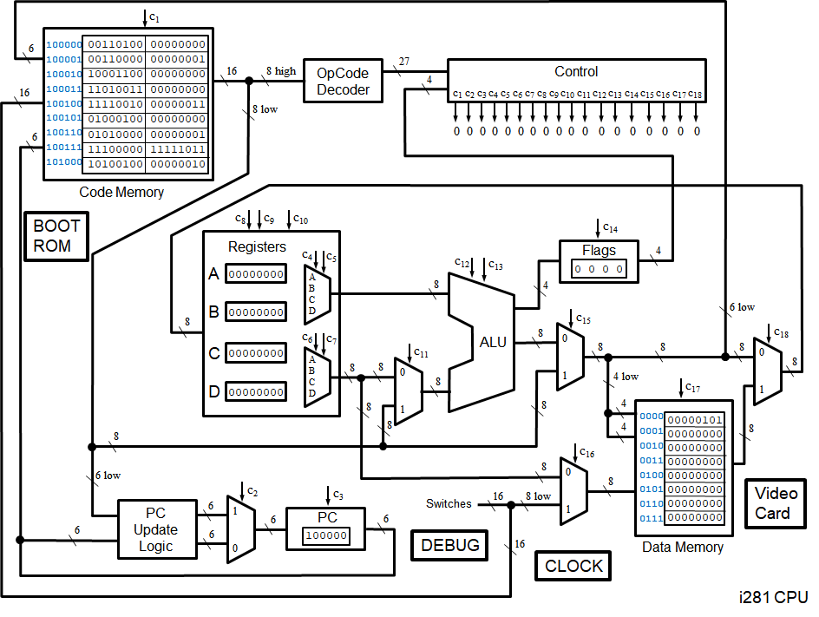
Final Diagram
Notes:
[Daryl]
BREAK THIS SLIDE UP INTO TINY PIECES WITH FULL IMAGE. Diagram, schematic, then implementation.
Building upon the original diagram from the FPGA implementation, several components will be grouped together to simplify implementation and group functionally similar components together. There will be twelve independent components of the processor:
4 independent 8-bit multiplexers
These are the individual components that are not incorporated directly into a CPU component.
Data Memory (& Video Card)
Due to how closely the video card interacts with the data memory storage, the video card and data memory will be combined.
Code Memory
This will store both BIOS and active user or example program alongside a visualization of the instruction and current program address.
Instruction Decoder
Both the Opcode decoder and control component are merged into a single component: the instruction decoder. Rather than developing a large logical circuit, we can simplify the design by combining both of these components. This will be discussed during the design plan.
Arithmetic Logic Unit (ALU)
The flag register will be grouped with the ALU as the ALU must make changes to the flags register depending on the instruction executed.
Program Counter
The PC Update logic circuit and multiplexer will be absorbed directly into the Program Counter as they interact closely together.
Register File
The register file is one of the only components that was not merged with neighboring CPU components as it acts upon itself without needing to directly modify any other component.
Boot ROM
Due to how boot operations will occur in the final design, a separate dedicated ROM storage called Boot ROM is needed. This will remain near the interface panel (switches).
Clock
The clock module was never directly include in the original diagram but it is still needed in the final design. This will be an independent component that will map a clock pulse line between five different components.
Regardless of how we implement this project, through breadboards or PCBs, this is our final separation of function between components.

Slide 26
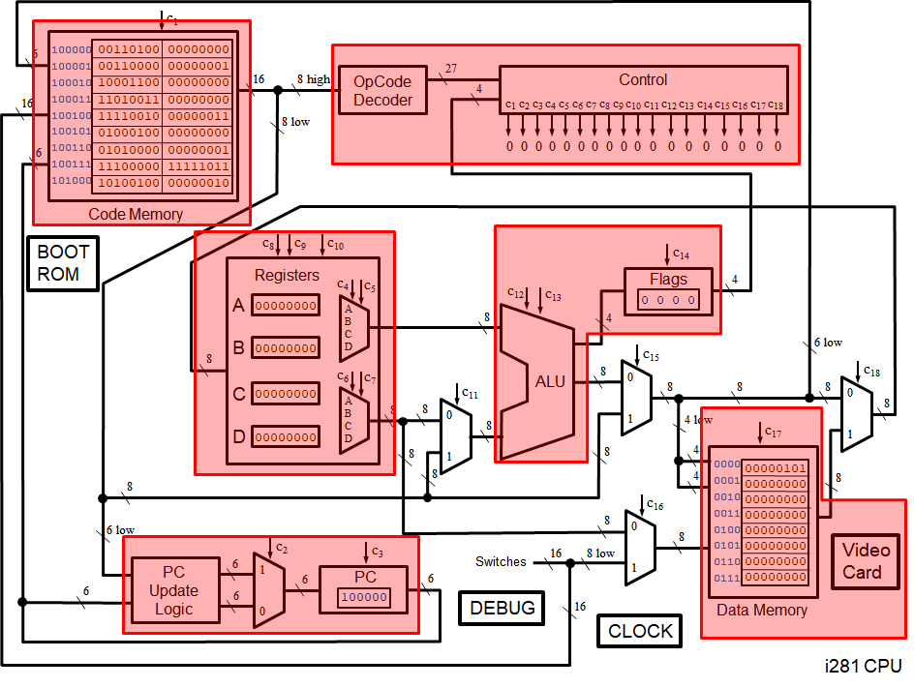
Final Diagram
Notes:
[Daryl]
BREAK THIS SLIDE UP INTO TINY PIECES WITH FULL IMAGE. Diagram, schematic, then implementation.
Building upon the original diagram from the FPGA implementation, several components will be grouped together to simplify implementation and group functionally similar components together. There will be twelve independent components of the processor:
4 independent 8-bit multiplexers
These are the individual components that are not incorporated directly into a CPU component.
Data Memory (& Video Card)
Due to how closely the video card interacts with the data memory storage, the video card and data memory will be combined.
Code Memory
This will store both BIOS and active user or example program alongside a visualization of the instruction and current program address.
Instruction Decoder
Both the Opcode decoder and control component are merged into a single component: the instruction decoder. Rather than developing a large logical circuit, we can simplify the design by combining both of these components. This will be discussed during the design plan.
Arithmetic Logic Unit (ALU)
The flag register will be grouped with the ALU as the ALU must make changes to the flags register depending on the instruction executed.
Program Counter
The PC Update logic circuit and multiplexer will be absorbed directly into the Program Counter as they interact closely together.
Register File
The register file is one of the only components that was not merged with neighboring CPU components as it acts upon itself without needing to directly modify any other component.
Boot ROM
Due to how boot operations will occur in the final design, a separate dedicated ROM storage called Boot ROM is needed. This will remain near the interface panel (switches).
Clock
The clock module was never directly include in the original diagram but it is still needed in the final design. This will be an independent component that will map a clock pulse line between five different components.
Regardless of how we implement this project, through breadboards or PCBs, this is our final separation of function between components.

Slide 27
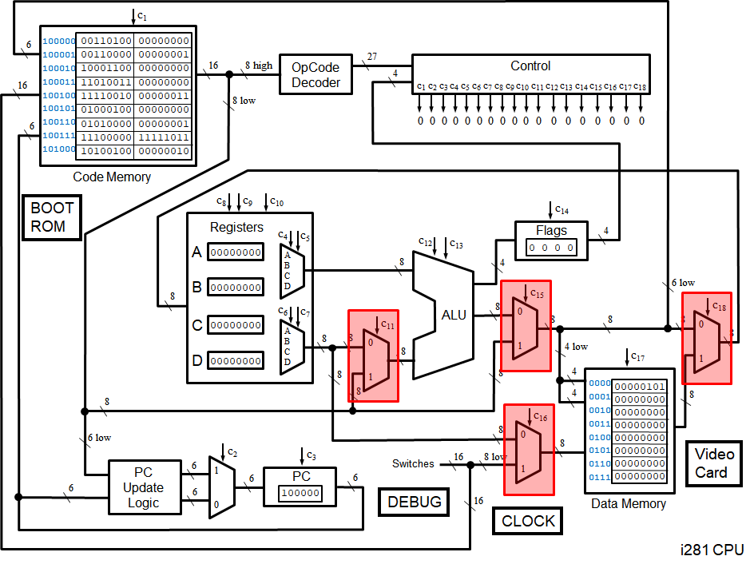
Bus MUXes
Notes:
[Daryl]
BREAK THIS SLIDE UP INTO TINY PIECES WITH FULL IMAGE. Diagram, schematic, then implementation.
Building upon the original diagram from the FPGA implementation, several components will be grouped together to simplify implementation and group functionally similar components together. There will be twelve independent components of the processor:
4 independent 8-bit multiplexers
These are the individual components that are not incorporated directly into a CPU component.
Data Memory (& Video Card)
Due to how closely the video card interacts with the data memory storage, the video card and data memory will be combined.
Code Memory
This will store both BIOS and active user or example program alongside a visualization of the instruction and current program address.
Instruction Decoder
Both the Opcode decoder and control component are merged into a single component: the instruction decoder. Rather than developing a large logical circuit, we can simplify the design by combining both of these components. This will be discussed during the design plan.
Arithmetic Logic Unit (ALU)
The flag register will be grouped with the ALU as the ALU must make changes to the flags register depending on the instruction executed.
Program Counter
The PC Update logic circuit and multiplexer will be absorbed directly into the Program Counter as they interact closely together.
Register File
The register file is one of the only components that was not merged with neighboring CPU components as it acts upon itself without needing to directly modify any other component.
Boot ROM
Due to how boot operations will occur in the final design, a separate dedicated ROM storage called Boot ROM is needed. This will remain near the interface panel (switches).
Clock
The clock module was never directly include in the original diagram but it is still needed in the final design. This will be an independent component that will map a clock pulse line between five different components.
Regardless of how we implement this project, through breadboards or PCBs, this is our final separation of function between components.

Slide 28
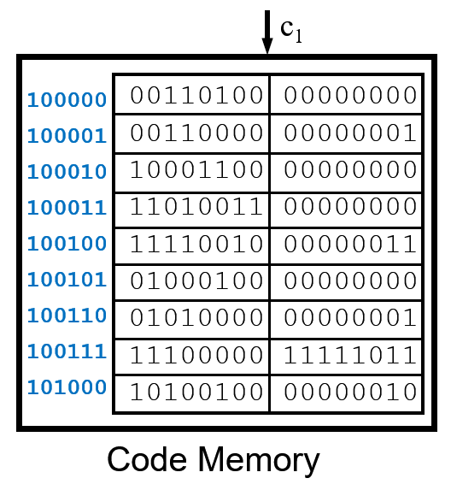
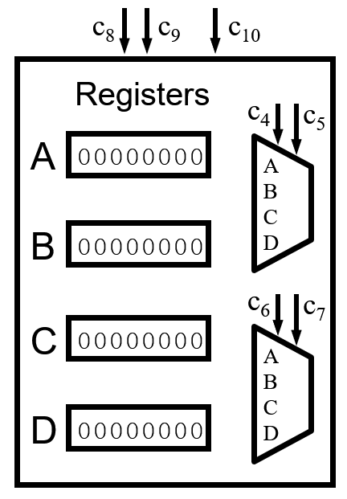
Independent Components
Notes:
[Daryl]
BREAK THIS SLIDE UP INTO TINY PIECES WITH FULL IMAGE. Diagram, schematic, then implementation.
Building upon the original diagram from the FPGA implementation, several components will be grouped together to simplify implementation and group functionally similar components together. There will be twelve independent components of the processor:
4 independent 8-bit multiplexers
These are the individual components that are not incorporated directly into a CPU component.
Data Memory (& Video Card)
Due to how closely the video card interacts with the data memory storage, the video card and data memory will be combined.
Code Memory
This will store both BIOS and active user or example program alongside a visualization of the instruction and current program address.
Instruction Decoder
Both the Opcode decoder and control component are merged into a single component: the instruction decoder. Rather than developing a large logical circuit, we can simplify the design by combining both of these components. This will be discussed during the design plan.
Arithmetic Logic Unit (ALU)
The flag register will be grouped with the ALU as the ALU must make changes to the flags register depending on the instruction executed.
Program Counter
The PC Update logic circuit and multiplexer will be absorbed directly into the Program Counter as they interact closely together.
Register File
The register file is one of the only components that was not merged with neighboring CPU components as it acts upon itself without needing to directly modify any other component.
Boot ROM
Due to how boot operations will occur in the final design, a separate dedicated ROM storage called Boot ROM is needed. This will remain near the interface panel (switches).
Clock
The clock module was never directly include in the original diagram but it is still needed in the final design. This will be an independent component that will map a clock pulse line between five different components.
Regardless of how we implement this project, through breadboards or PCBs, this is our final separation of function between components.

Slide 29
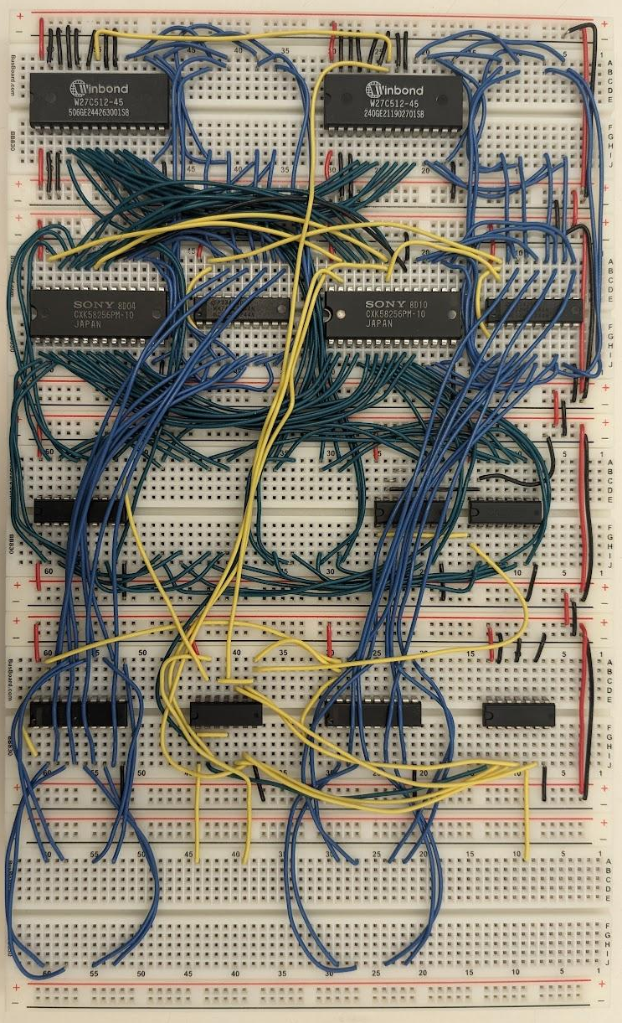
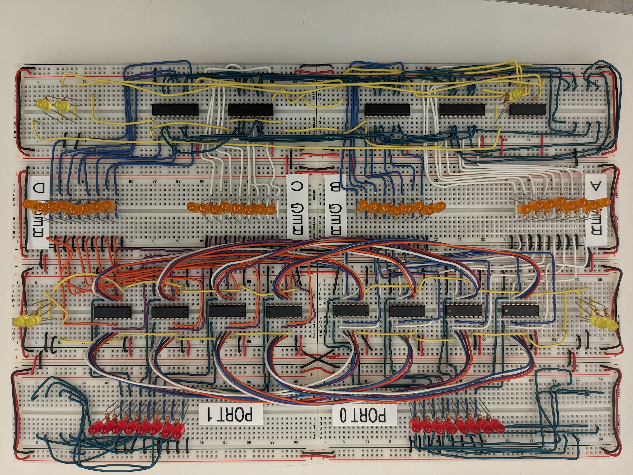
Code Memory and Register File
Notes:
[Daryl]
BREAK THIS SLIDE UP INTO TINY PIECES WITH FULL IMAGE. Diagram, schematic, then implementation.
Building upon the original diagram from the FPGA implementation, several components will be grouped together to simplify implementation and group functionally similar components together. There will be twelve independent components of the processor:
4 independent 8-bit multiplexers
These are the individual components that are not incorporated directly into a CPU component.
Data Memory (& Video Card)
Due to how closely the video card interacts with the data memory storage, the video card and data memory will be combined.
Code Memory
This will store both BIOS and active user or example program alongside a visualization of the instruction and current program address.
Instruction Decoder
Both the Opcode decoder and control component are merged into a single component: the instruction decoder. Rather than developing a large logical circuit, we can simplify the design by combining both of these components. This will be discussed during the design plan.
Arithmetic Logic Unit (ALU)
The flag register will be grouped with the ALU as the ALU must make changes to the flags register depending on the instruction executed.
Program Counter
The PC Update logic circuit and multiplexer will be absorbed directly into the Program Counter as they interact closely together.
Register File
The register file is one of the only components that was not merged with neighboring CPU components as it acts upon itself without needing to directly modify any other component.
Boot ROM
Due to how boot operations will occur in the final design, a separate dedicated ROM storage called Boot ROM is needed. This will remain near the interface panel (switches).
Clock
The clock module was never directly include in the original diagram but it is still needed in the final design. This will be an independent component that will map a clock pulse line between five different components.
Regardless of how we implement this project, through breadboards or PCBs, this is our final separation of function between components.

Slide 30
Program Counter
Notes:
[Daryl]
BREAK THIS SLIDE UP INTO TINY PIECES WITH FULL IMAGE. Diagram, schematic, then implementation.
Building upon the original diagram from the FPGA implementation, several components will be grouped together to simplify implementation and group functionally similar components together. There will be twelve independent components of the processor:
4 independent 8-bit multiplexers
These are the individual components that are not incorporated directly into a CPU component.
Data Memory (& Video Card)
Due to how closely the video card interacts with the data memory storage, the video card and data memory will be combined.
Code Memory
This will store both BIOS and active user or example program alongside a visualization of the instruction and current program address.
Instruction Decoder
Both the Opcode decoder and control component are merged into a single component: the instruction decoder. Rather than developing a large logical circuit, we can simplify the design by combining both of these components. This will be discussed during the design plan.
Arithmetic Logic Unit (ALU)
The flag register will be grouped with the ALU as the ALU must make changes to the flags register depending on the instruction executed.
Program Counter
The PC Update logic circuit and multiplexer will be absorbed directly into the Program Counter as they interact closely together.
Register File
The register file is one of the only components that was not merged with neighboring CPU components as it acts upon itself without needing to directly modify any other component.
Boot ROM
Due to how boot operations will occur in the final design, a separate dedicated ROM storage called Boot ROM is needed. This will remain near the interface panel (switches).
Clock
The clock module was never directly include in the original diagram but it is still needed in the final design. This will be an independent component that will map a clock pulse line between five different components.
Regardless of how we implement this project, through breadboards or PCBs, this is our final separation of function between components.

Slide 31
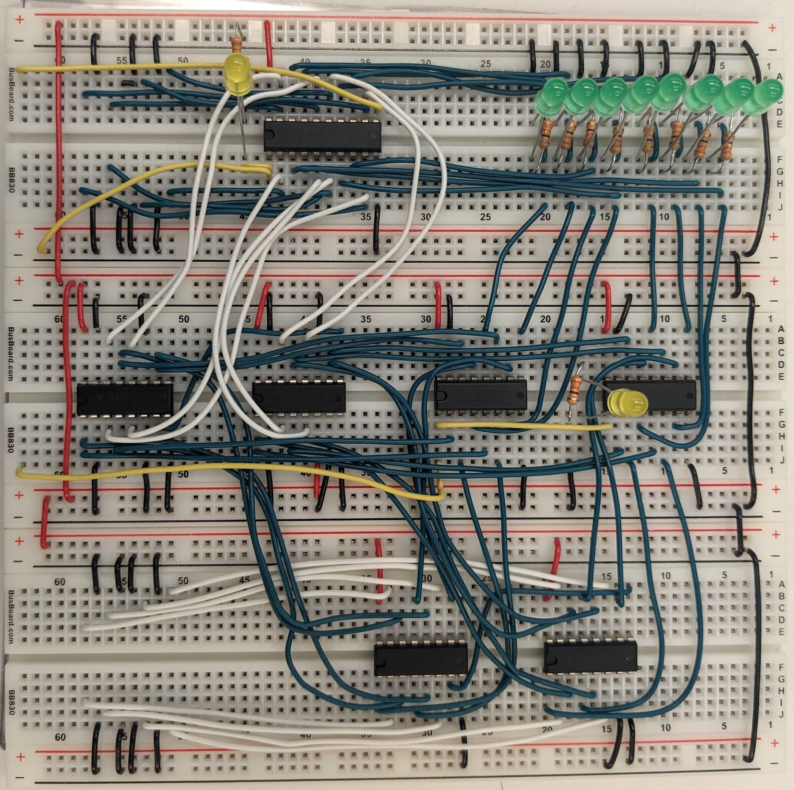
Program Counter
Notes:
[Daryl]
BREAK THIS SLIDE UP INTO TINY PIECES WITH FULL IMAGE. Diagram, schematic, then implementation.
Building upon the original diagram from the FPGA implementation, several components will be grouped together to simplify implementation and group functionally similar components together. There will be twelve independent components of the processor:
4 independent 8-bit multiplexers
These are the individual components that are not incorporated directly into a CPU component.
Data Memory (& Video Card)
Due to how closely the video card interacts with the data memory storage, the video card and data memory will be combined.
Code Memory
This will store both BIOS and active user or example program alongside a visualization of the instruction and current program address.
Instruction Decoder
Both the Opcode decoder and control component are merged into a single component: the instruction decoder. Rather than developing a large logical circuit, we can simplify the design by combining both of these components. This will be discussed during the design plan.
Arithmetic Logic Unit (ALU)
The flag register will be grouped with the ALU as the ALU must make changes to the flags register depending on the instruction executed.
Program Counter
The PC Update logic circuit and multiplexer will be absorbed directly into the Program Counter as they interact closely together.
Register File
The register file is one of the only components that was not merged with neighboring CPU components as it acts upon itself without needing to directly modify any other component.
Boot ROM
Due to how boot operations will occur in the final design, a separate dedicated ROM storage called Boot ROM is needed. This will remain near the interface panel (switches).
Clock
The clock module was never directly include in the original diagram but it is still needed in the final design. This will be an independent component that will map a clock pulse line between five different components.
Regardless of how we implement this project, through breadboards or PCBs, this is our final separation of function between components.

Slide 32
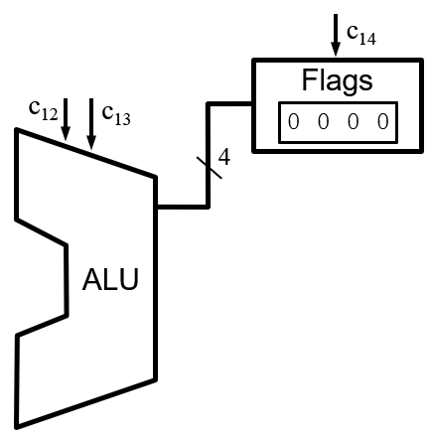
ALU with Flag Register
Notes:
[Daryl]
BREAK THIS SLIDE UP INTO TINY PIECES WITH FULL IMAGE. Diagram, schematic, then implementation.
Building upon the original diagram from the FPGA implementation, several components will be grouped together to simplify implementation and group functionally similar components together. There will be twelve independent components of the processor:
4 independent 8-bit multiplexers
These are the individual components that are not incorporated directly into a CPU component.
Data Memory (& Video Card)
Due to how closely the video card interacts with the data memory storage, the video card and data memory will be combined.
Code Memory
This will store both BIOS and active user or example program alongside a visualization of the instruction and current program address.
Instruction Decoder
Both the Opcode decoder and control component are merged into a single component: the instruction decoder. Rather than developing a large logical circuit, we can simplify the design by combining both of these components. This will be discussed during the design plan.
Arithmetic Logic Unit (ALU)
The flag register will be grouped with the ALU as the ALU must make changes to the flags register depending on the instruction executed.
Program Counter
The PC Update logic circuit and multiplexer will be absorbed directly into the Program Counter as they interact closely together.
Register File
The register file is one of the only components that was not merged with neighboring CPU components as it acts upon itself without needing to directly modify any other component.
Boot ROM
Due to how boot operations will occur in the final design, a separate dedicated ROM storage called Boot ROM is needed. This will remain near the interface panel (switches).
Clock
The clock module was never directly include in the original diagram but it is still needed in the final design. This will be an independent component that will map a clock pulse line between five different components.
Regardless of how we implement this project, through breadboards or PCBs, this is our final separation of function between components.

Slide 33
ALU with Flag Register
Notes:
[Daryl]
BREAK THIS SLIDE UP INTO TINY PIECES WITH FULL IMAGE. Diagram, schematic, then implementation.
Building upon the original diagram from the FPGA implementation, several components will be grouped together to simplify implementation and group functionally similar components together. There will be twelve independent components of the processor:
4 independent 8-bit multiplexers
These are the individual components that are not incorporated directly into a CPU component.
Data Memory (& Video Card)
Due to how closely the video card interacts with the data memory storage, the video card and data memory will be combined.
Code Memory
This will store both BIOS and active user or example program alongside a visualization of the instruction and current program address.
Instruction Decoder
Both the Opcode decoder and control component are merged into a single component: the instruction decoder. Rather than developing a large logical circuit, we can simplify the design by combining both of these components. This will be discussed during the design plan.
Arithmetic Logic Unit (ALU)
The flag register will be grouped with the ALU as the ALU must make changes to the flags register depending on the instruction executed.
Program Counter
The PC Update logic circuit and multiplexer will be absorbed directly into the Program Counter as they interact closely together.
Register File
The register file is one of the only components that was not merged with neighboring CPU components as it acts upon itself without needing to directly modify any other component.
Boot ROM
Due to how boot operations will occur in the final design, a separate dedicated ROM storage called Boot ROM is needed. This will remain near the interface panel (switches).
Clock
The clock module was never directly include in the original diagram but it is still needed in the final design. This will be an independent component that will map a clock pulse line between five different components.
Regardless of how we implement this project, through breadboards or PCBs, this is our final separation of function between components.

Slide 34
Instruction Decoder
Notes:
[Daryl]
BREAK THIS SLIDE UP INTO TINY PIECES WITH FULL IMAGE. Diagram, schematic, then implementation.
Building upon the original diagram from the FPGA implementation, several components will be grouped together to simplify implementation and group functionally similar components together. There will be twelve independent components of the processor:
4 independent 8-bit multiplexers
These are the individual components that are not incorporated directly into a CPU component.
Data Memory (& Video Card)
Due to how closely the video card interacts with the data memory storage, the video card and data memory will be combined.
Code Memory
This will store both BIOS and active user or example program alongside a visualization of the instruction and current program address.
Instruction Decoder
Both the Opcode decoder and control component are merged into a single component: the instruction decoder. Rather than developing a large logical circuit, we can simplify the design by combining both of these components. This will be discussed during the design plan.
Arithmetic Logic Unit (ALU)
The flag register will be grouped with the ALU as the ALU must make changes to the flags register depending on the instruction executed.
Program Counter
The PC Update logic circuit and multiplexer will be absorbed directly into the Program Counter as they interact closely together.
Register File
The register file is one of the only components that was not merged with neighboring CPU components as it acts upon itself without needing to directly modify any other component.
Boot ROM
Due to how boot operations will occur in the final design, a separate dedicated ROM storage called Boot ROM is needed. This will remain near the interface panel (switches).
Clock
The clock module was never directly include in the original diagram but it is still needed in the final design. This will be an independent component that will map a clock pulse line between five different components.
Regardless of how we implement this project, through breadboards or PCBs, this is our final separation of function between components.

Slide 35
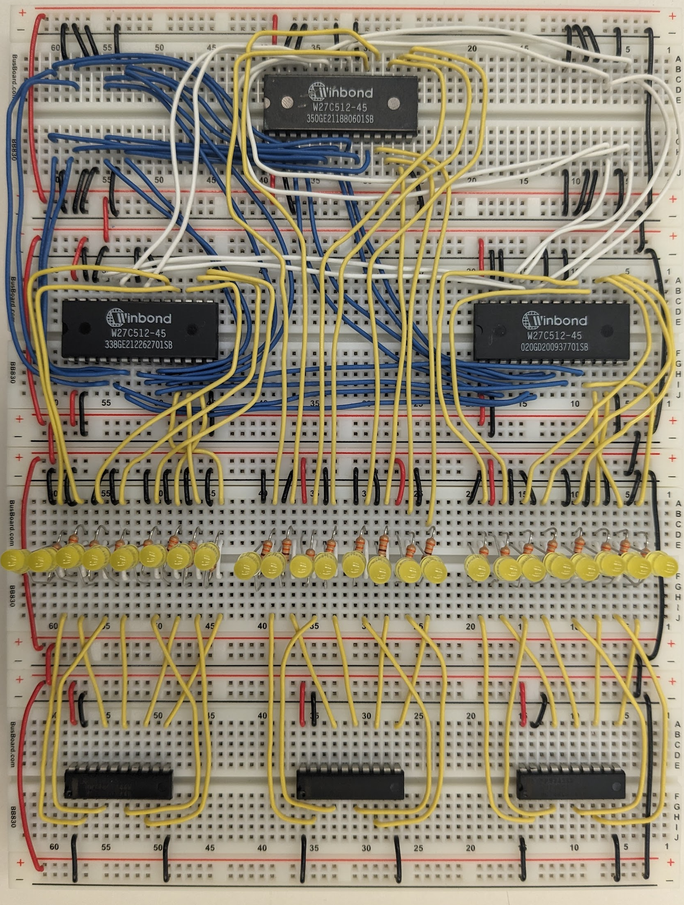
Instruction Decoder
Notes:
[Daryl]
BREAK THIS SLIDE UP INTO TINY PIECES WITH FULL IMAGE. Diagram, schematic, then implementation.
Building upon the original diagram from the FPGA implementation, several components will be grouped together to simplify implementation and group functionally similar components together. There will be twelve independent components of the processor:
4 independent 8-bit multiplexers
These are the individual components that are not incorporated directly into a CPU component.
Data Memory (& Video Card)
Due to how closely the video card interacts with the data memory storage, the video card and data memory will be combined.
Code Memory
This will store both BIOS and active user or example program alongside a visualization of the instruction and current program address.
Instruction Decoder
Both the Opcode decoder and control component are merged into a single component: the instruction decoder. Rather than developing a large logical circuit, we can simplify the design by combining both of these components. This will be discussed during the design plan.
Arithmetic Logic Unit (ALU)
The flag register will be grouped with the ALU as the ALU must make changes to the flags register depending on the instruction executed.
Program Counter
The PC Update logic circuit and multiplexer will be absorbed directly into the Program Counter as they interact closely together.
Register File
The register file is one of the only components that was not merged with neighboring CPU components as it acts upon itself without needing to directly modify any other component.
Boot ROM
Due to how boot operations will occur in the final design, a separate dedicated ROM storage called Boot ROM is needed. This will remain near the interface panel (switches).
Clock
The clock module was never directly include in the original diagram but it is still needed in the final design. This will be an independent component that will map a clock pulse line between five different components.
Regardless of how we implement this project, through breadboards or PCBs, this is our final separation of function between components.

Slide 36
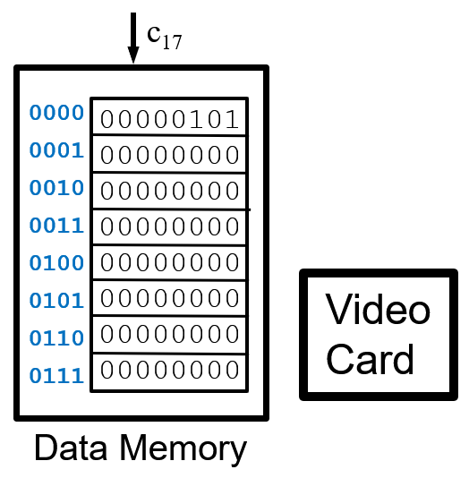
Data Memory and Video Card
Notes:
[Daryl]
BREAK THIS SLIDE UP INTO TINY PIECES WITH FULL IMAGE. Diagram, schematic, then implementation.
Building upon the original diagram from the FPGA implementation, several components will be grouped together to simplify implementation and group functionally similar components together. There will be twelve independent components of the processor:
4 independent 8-bit multiplexers
These are the individual components that are not incorporated directly into a CPU component.
Data Memory (& Video Card)
Due to how closely the video card interacts with the data memory storage, the video card and data memory will be combined.
Code Memory
This will store both BIOS and active user or example program alongside a visualization of the instruction and current program address.
Instruction Decoder
Both the Opcode decoder and control component are merged into a single component: the instruction decoder. Rather than developing a large logical circuit, we can simplify the design by combining both of these components. This will be discussed during the design plan.
Arithmetic Logic Unit (ALU)
The flag register will be grouped with the ALU as the ALU must make changes to the flags register depending on the instruction executed.
Program Counter
The PC Update logic circuit and multiplexer will be absorbed directly into the Program Counter as they interact closely together.
Register File
The register file is one of the only components that was not merged with neighboring CPU components as it acts upon itself without needing to directly modify any other component.
Boot ROM
Due to how boot operations will occur in the final design, a separate dedicated ROM storage called Boot ROM is needed. This will remain near the interface panel (switches).
Clock
The clock module was never directly include in the original diagram but it is still needed in the final design. This will be an independent component that will map a clock pulse line between five different components.
Regardless of how we implement this project, through breadboards or PCBs, this is our final separation of function between components.

Slide 37
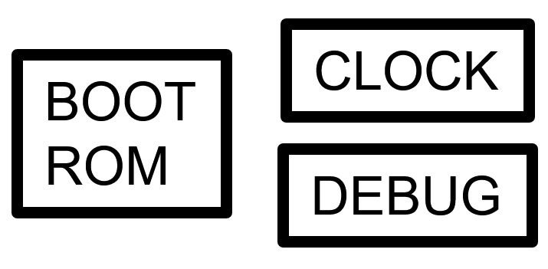
New Components
Notes:
[Daryl]
BREAK THIS SLIDE UP INTO TINY PIECES WITH FULL IMAGE. Diagram, schematic, then implementation.
Building upon the original diagram from the FPGA implementation, several components will be grouped together to simplify implementation and group functionally similar components together. There will be twelve independent components of the processor:
4 independent 8-bit multiplexers
These are the individual components that are not incorporated directly into a CPU component.
Data Memory (& Video Card)
Due to how closely the video card interacts with the data memory storage, the video card and data memory will be combined.
Code Memory
This will store both BIOS and active user or example program alongside a visualization of the instruction and current program address.
Instruction Decoder
Both the Opcode decoder and control component are merged into a single component: the instruction decoder. Rather than developing a large logical circuit, we can simplify the design by combining both of these components. This will be discussed during the design plan.
Arithmetic Logic Unit (ALU)
The flag register will be grouped with the ALU as the ALU must make changes to the flags register depending on the instruction executed.
Program Counter
The PC Update logic circuit and multiplexer will be absorbed directly into the Program Counter as they interact closely together.
Register File
The register file is one of the only components that was not merged with neighboring CPU components as it acts upon itself without needing to directly modify any other component.
Boot ROM
Due to how boot operations will occur in the final design, a separate dedicated ROM storage called Boot ROM is needed. This will remain near the interface panel (switches).
Clock
The clock module was never directly include in the original diagram but it is still needed in the final design. This will be an independent component that will map a clock pulse line between five different components.
Regardless of how we implement this project, through breadboards or PCBs, this is our final separation of function between components.

Slide 38
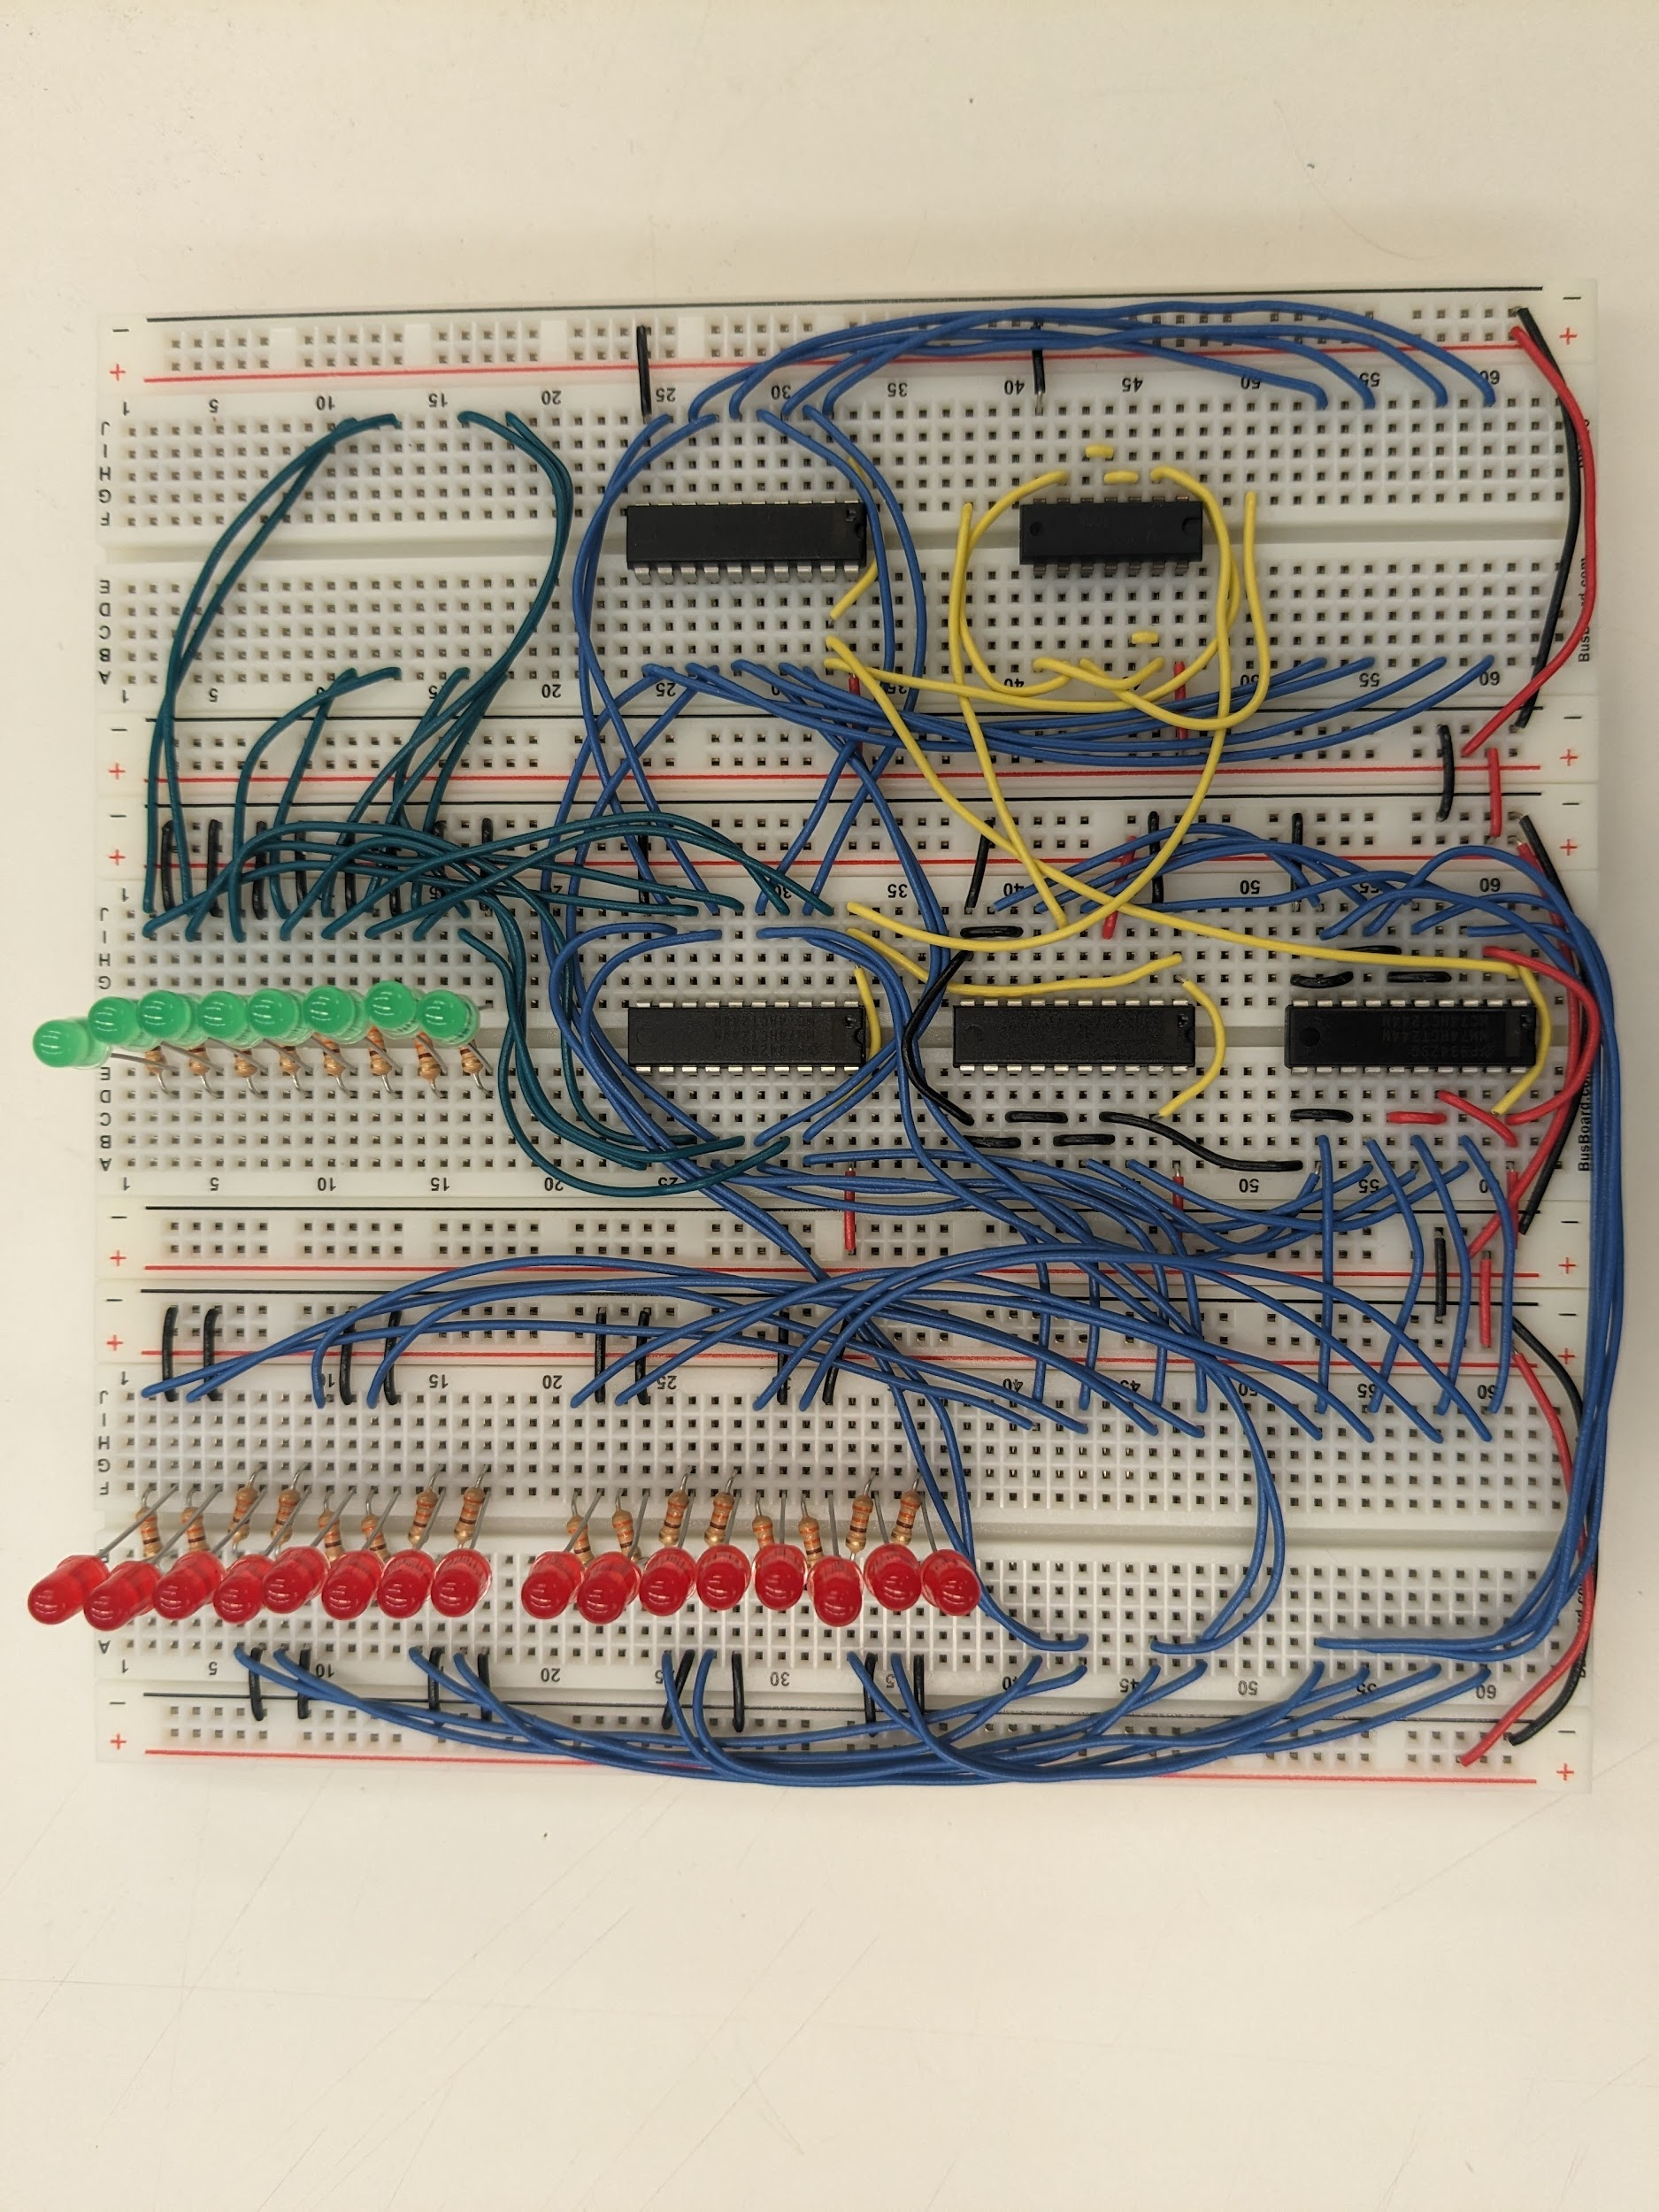
Debug and Clock
Notes:
[Daryl]
BREAK THIS SLIDE UP INTO TINY PIECES WITH FULL IMAGE. Diagram, schematic, then implementation.
Building upon the original diagram from the FPGA implementation, several components will be grouped together to simplify implementation and group functionally similar components together. There will be twelve independent components of the processor:
4 independent 8-bit multiplexers
These are the individual components that are not incorporated directly into a CPU component.
Data Memory (& Video Card)
Due to how closely the video card interacts with the data memory storage, the video card and data memory will be combined.
Code Memory
This will store both BIOS and active user or example program alongside a visualization of the instruction and current program address.
Instruction Decoder
Both the Opcode decoder and control component are merged into a single component: the instruction decoder. Rather than developing a large logical circuit, we can simplify the design by combining both of these components. This will be discussed during the design plan.
Arithmetic Logic Unit (ALU)
The flag register will be grouped with the ALU as the ALU must make changes to the flags register depending on the instruction executed.
Program Counter
The PC Update logic circuit and multiplexer will be absorbed directly into the Program Counter as they interact closely together.
Register File
The register file is one of the only components that was not merged with neighboring CPU components as it acts upon itself without needing to directly modify any other component.
Boot ROM
Due to how boot operations will occur in the final design, a separate dedicated ROM storage called Boot ROM is needed. This will remain near the interface panel (switches).
Clock
The clock module was never directly include in the original diagram but it is still needed in the final design. This will be an independent component that will map a clock pulse line between five different components.
Regardless of how we implement this project, through breadboards or PCBs, this is our final separation of function between components.

Slide 39
Final Diagram
Notes:
[Daryl]
BREAK THIS SLIDE UP INTO TINY PIECES WITH FULL IMAGE. Diagram, schematic, then implementation.
Building upon the original diagram from the FPGA implementation, several components will be grouped together to simplify implementation and group functionally similar components together. There will be twelve independent components of the processor:
4 independent 8-bit multiplexers
These are the individual components that are not incorporated directly into a CPU component.
Data Memory (& Video Card)
Due to how closely the video card interacts with the data memory storage, the video card and data memory will be combined.
Code Memory
This will store both BIOS and active user or example program alongside a visualization of the instruction and current program address.
Instruction Decoder
Both the Opcode decoder and control component are merged into a single component: the instruction decoder. Rather than developing a large logical circuit, we can simplify the design by combining both of these components. This will be discussed during the design plan.
Arithmetic Logic Unit (ALU)
The flag register will be grouped with the ALU as the ALU must make changes to the flags register depending on the instruction executed.
Program Counter
The PC Update logic circuit and multiplexer will be absorbed directly into the Program Counter as they interact closely together.
Register File
The register file is one of the only components that was not merged with neighboring CPU components as it acts upon itself without needing to directly modify any other component.
Boot ROM
Due to how boot operations will occur in the final design, a separate dedicated ROM storage called Boot ROM is needed. This will remain near the interface panel (switches).
Clock
The clock module was never directly include in the original diagram but it is still needed in the final design. This will be an independent component that will map a clock pulse line between five different components.
Regardless of how we implement this project, through breadboards or PCBs, this is our final separation of function between components.

Slide 40
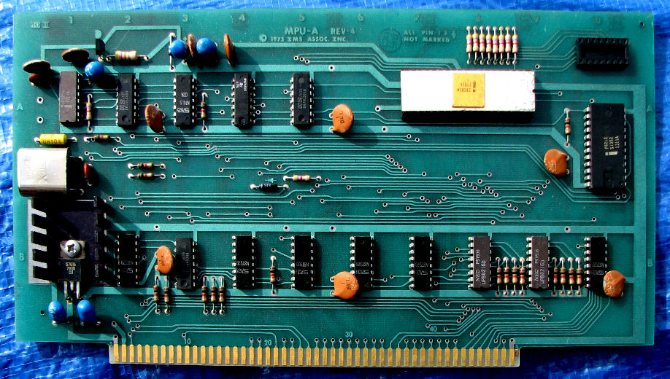
System Design
IEEE-696 Standard
Due to technological similarities, we are using old-school computer design techniques to build our modules.
Notes:
[GAVIN] The biggest challenge that we must overcome as a group is figuring out how to turn the logical description of the i281 CPU into actual hardware. When designing for an FPGA, all of the gates can just be described and then automatically synthesized, but the process is a bit different for discrete hardware. Current draw, signal interference, and gate propagation delays must be taken into account. The IEEE-696 is an older standard, but it gives good insight on how to correctly build a computer using discrete logic gates.

Slide 41
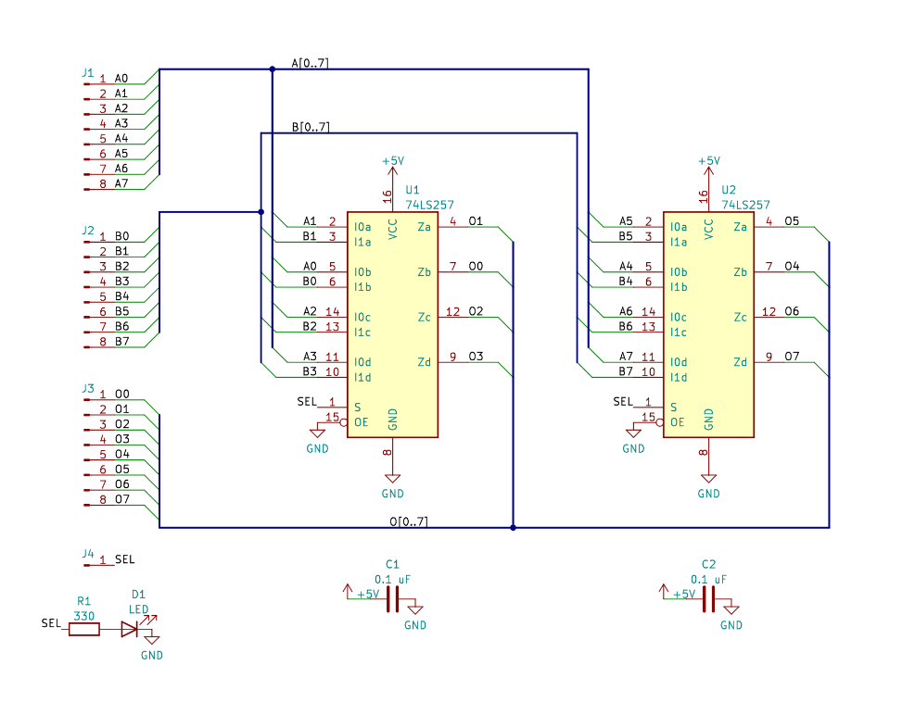
System Design
Each module starts as a chip-level electrical schematic.
Pictures is the schematic for the MUX
Notes:
[GAVIN]
DROP MOST OF THE TEXT, but keep the scheme. Place BEFORE the high-level final diagram to do the components. Put ALL IMAGES IN CONTEXT.
The first part of our design process involves taking the conceptual design “sections” and turning them into discrete modules. To do this, each module is first drawn in KiCAD as an electrical schematic. Even though the wiring doesn’t map directly to what will be made on the breadboards, it allows us to figure out what components are needed and roughly how they will interconnect.

Slide 42
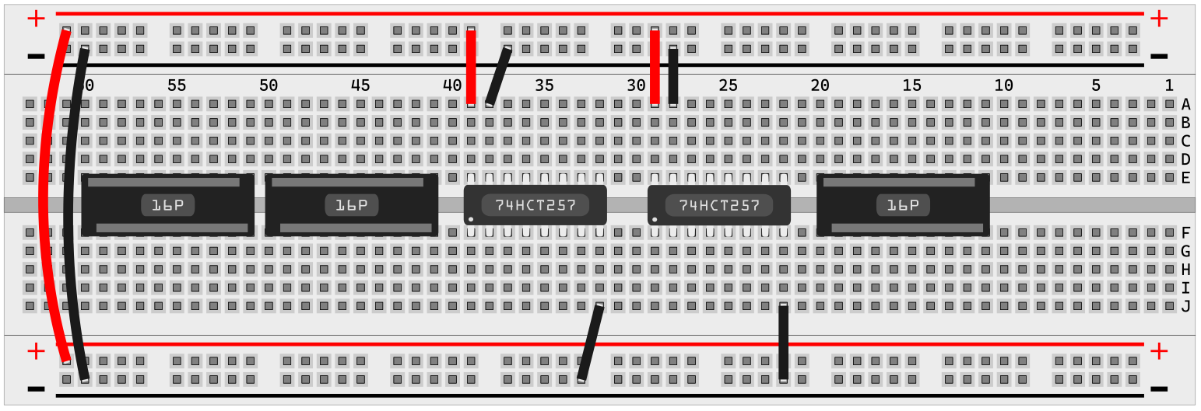
System Design
After the logical schematic is finished, it must be translated into something that can be built on a breadboard.
A rough component outline of each module is created before physical assembly can begin.
Notes:
[GAVIN] After the KiCAD schematic is done, it must be converted into a design that can be made on a breadboard. The major task here is to figure out where all of the components will physically be placed on the breadboards. External connectivity, easy of wiring, and understability all must be taken into account.

Slide 43
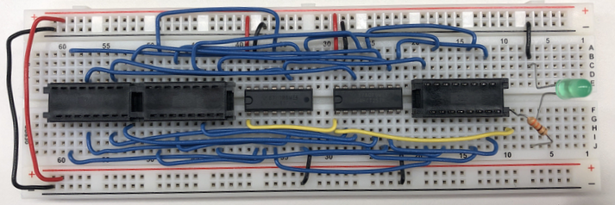
System Design
Once a breadboard layout is finished, it can be physically implemented.
Ribbon cable is used with the black connectors to transfer data across modules.
Notes:
[GAVIN] After the KiCAD schematic is done, it must be converted into a design that can be made on a breadboard. The major task here is to figure out where all of the components will physically be placed on the breadboards. External connectivity, easy of wiring, and understability all must be taken into account.

Slide 44
Code Memory Module
Control Table Module
Register File Module
Program Counter Module
Arithmetic Logic Module
Data Memory + Video Card Module
Multiplexer Module
Boot Module
User Panel Module
Clock Module
Debug Module
System Modules
Notes:
[GAVIN] A step above individual modules is how all of the different modules combine to form the complete system. There are about 12 distinct modules that need to be constructed to implement the final design. Some of these modules, such as the multiplexer, will need to be constructed multiple times.

Slide 45
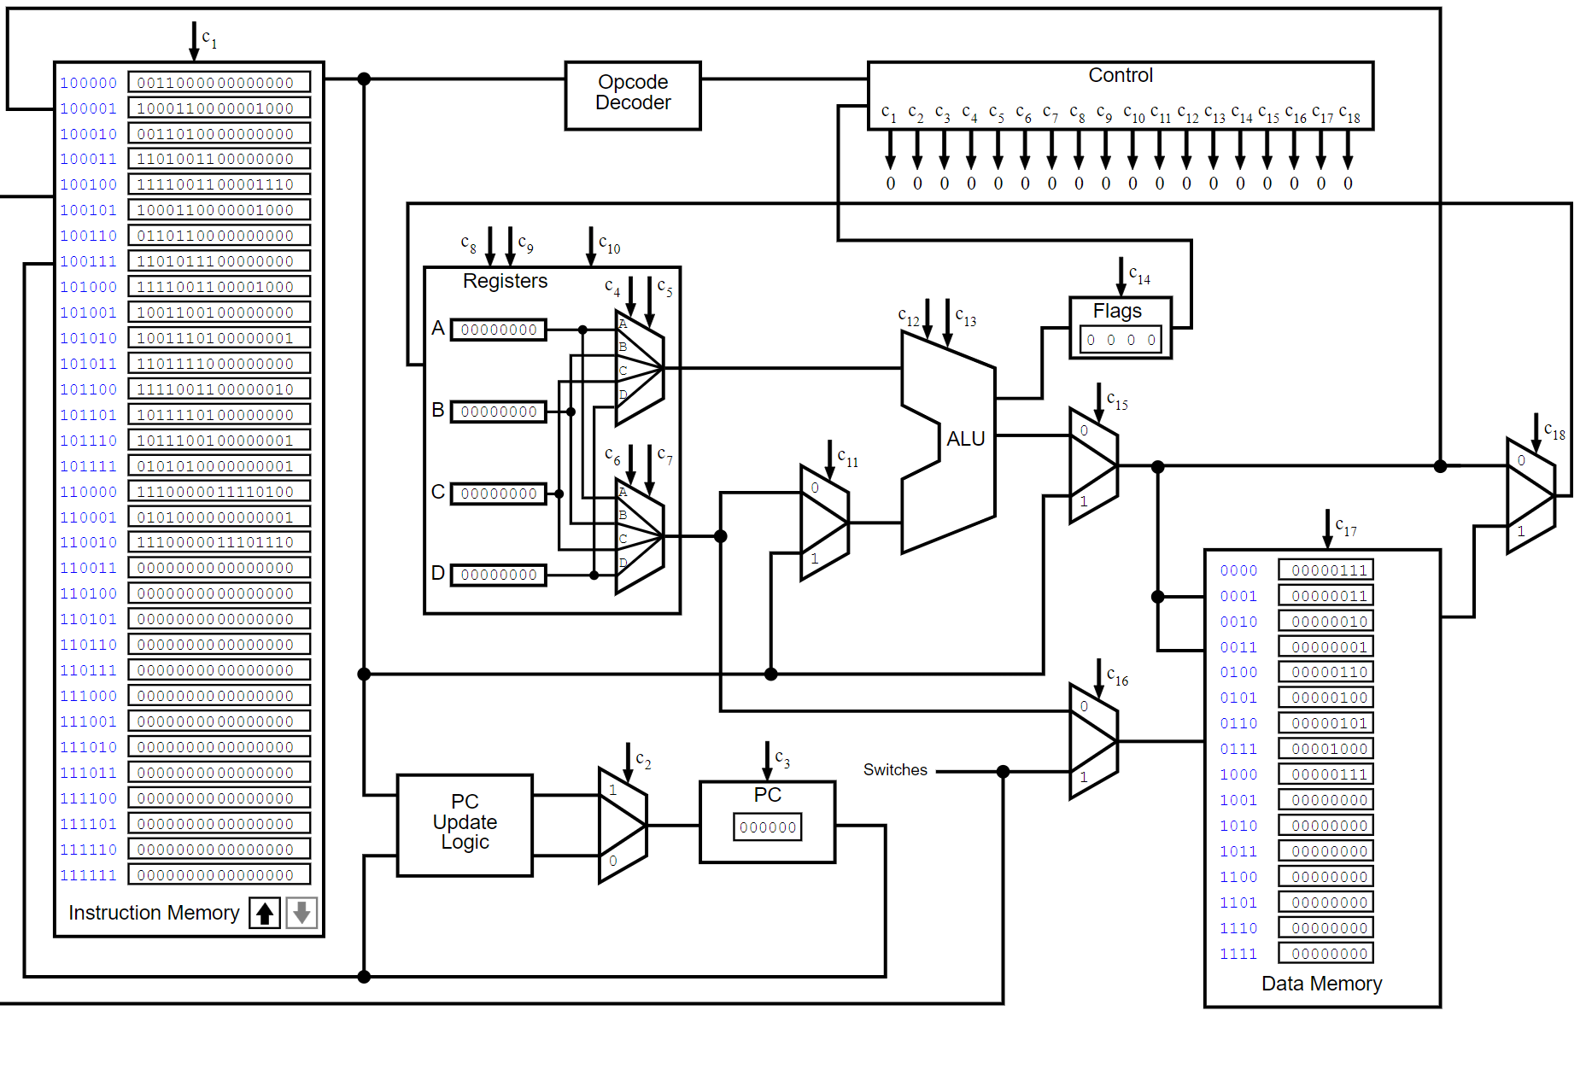
System Design
Once enough modules have been constructed, the high-level system design can be implemented.
This involves connecting the modules to match the conceptual i281 design.
Assuming that all modules work as intended, the finished system should be fully compatible with all existing i281 software.
Notes:
[GAVIN]
DISCUSS THE RIBBON CABLES HERE. (include a ribbon cable picture)
Redo diagram, there is a bad crop
Once enough modules have been completed, the highest level of the system design can finally be implemented. All of the modules are designed to be interconnected in the same way that the conceptual design is laid out. This will result in a physical implementation that works nearly identically to the conceptual i281 design that is taught in CpRE 281.

Slide 46
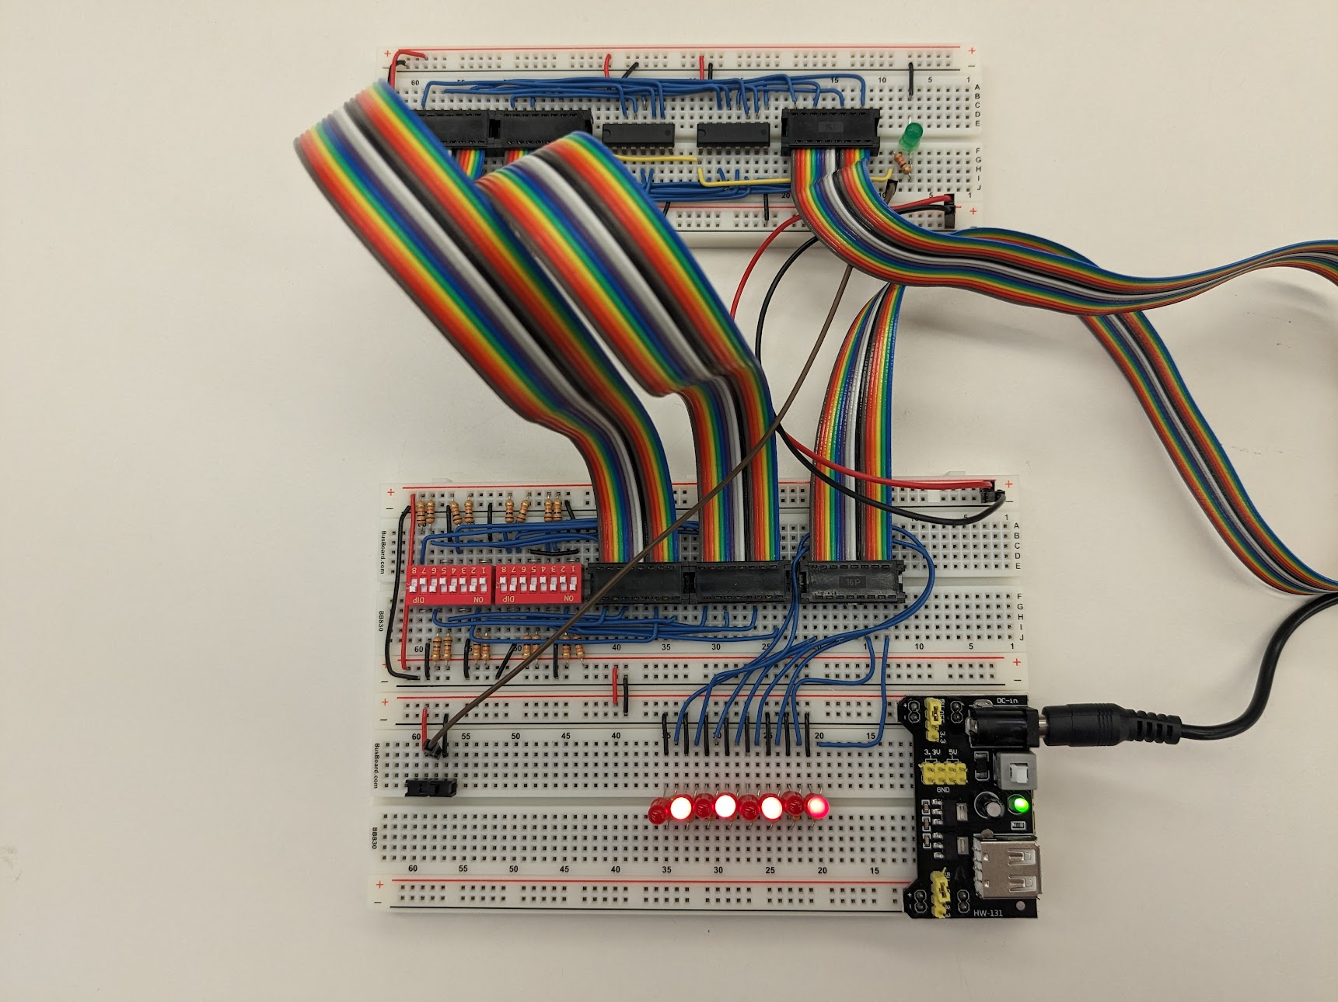
Prototype Implementations
Since this project is more implementation heavy, most of our first semester was focused on constructing our prototype.
The project requirements call for the first version of the i281 CPU to be built on solderless breadboards. This allowed us to build each module and test as we progressed.
When an issue with a module was found, it could easily be corrected, and it’s KiCAD design schematics updated.
Notes:
[GAVIN]

Slide 47
Prototype Implementations
As the semester progressed, we implemented enough of the prototype modules that we were able to construct a minimally viable processor (MVP).
The MVP lacks a number of features that will be present on the finished product, but it allows most of the critical modules to be integration tested using simple test programs.
Notes:
[GAVIN]

Slide 48
Breadboard Implementation
Notes:
[Daryl]
Put circles over a static image and relate to

Slide 49
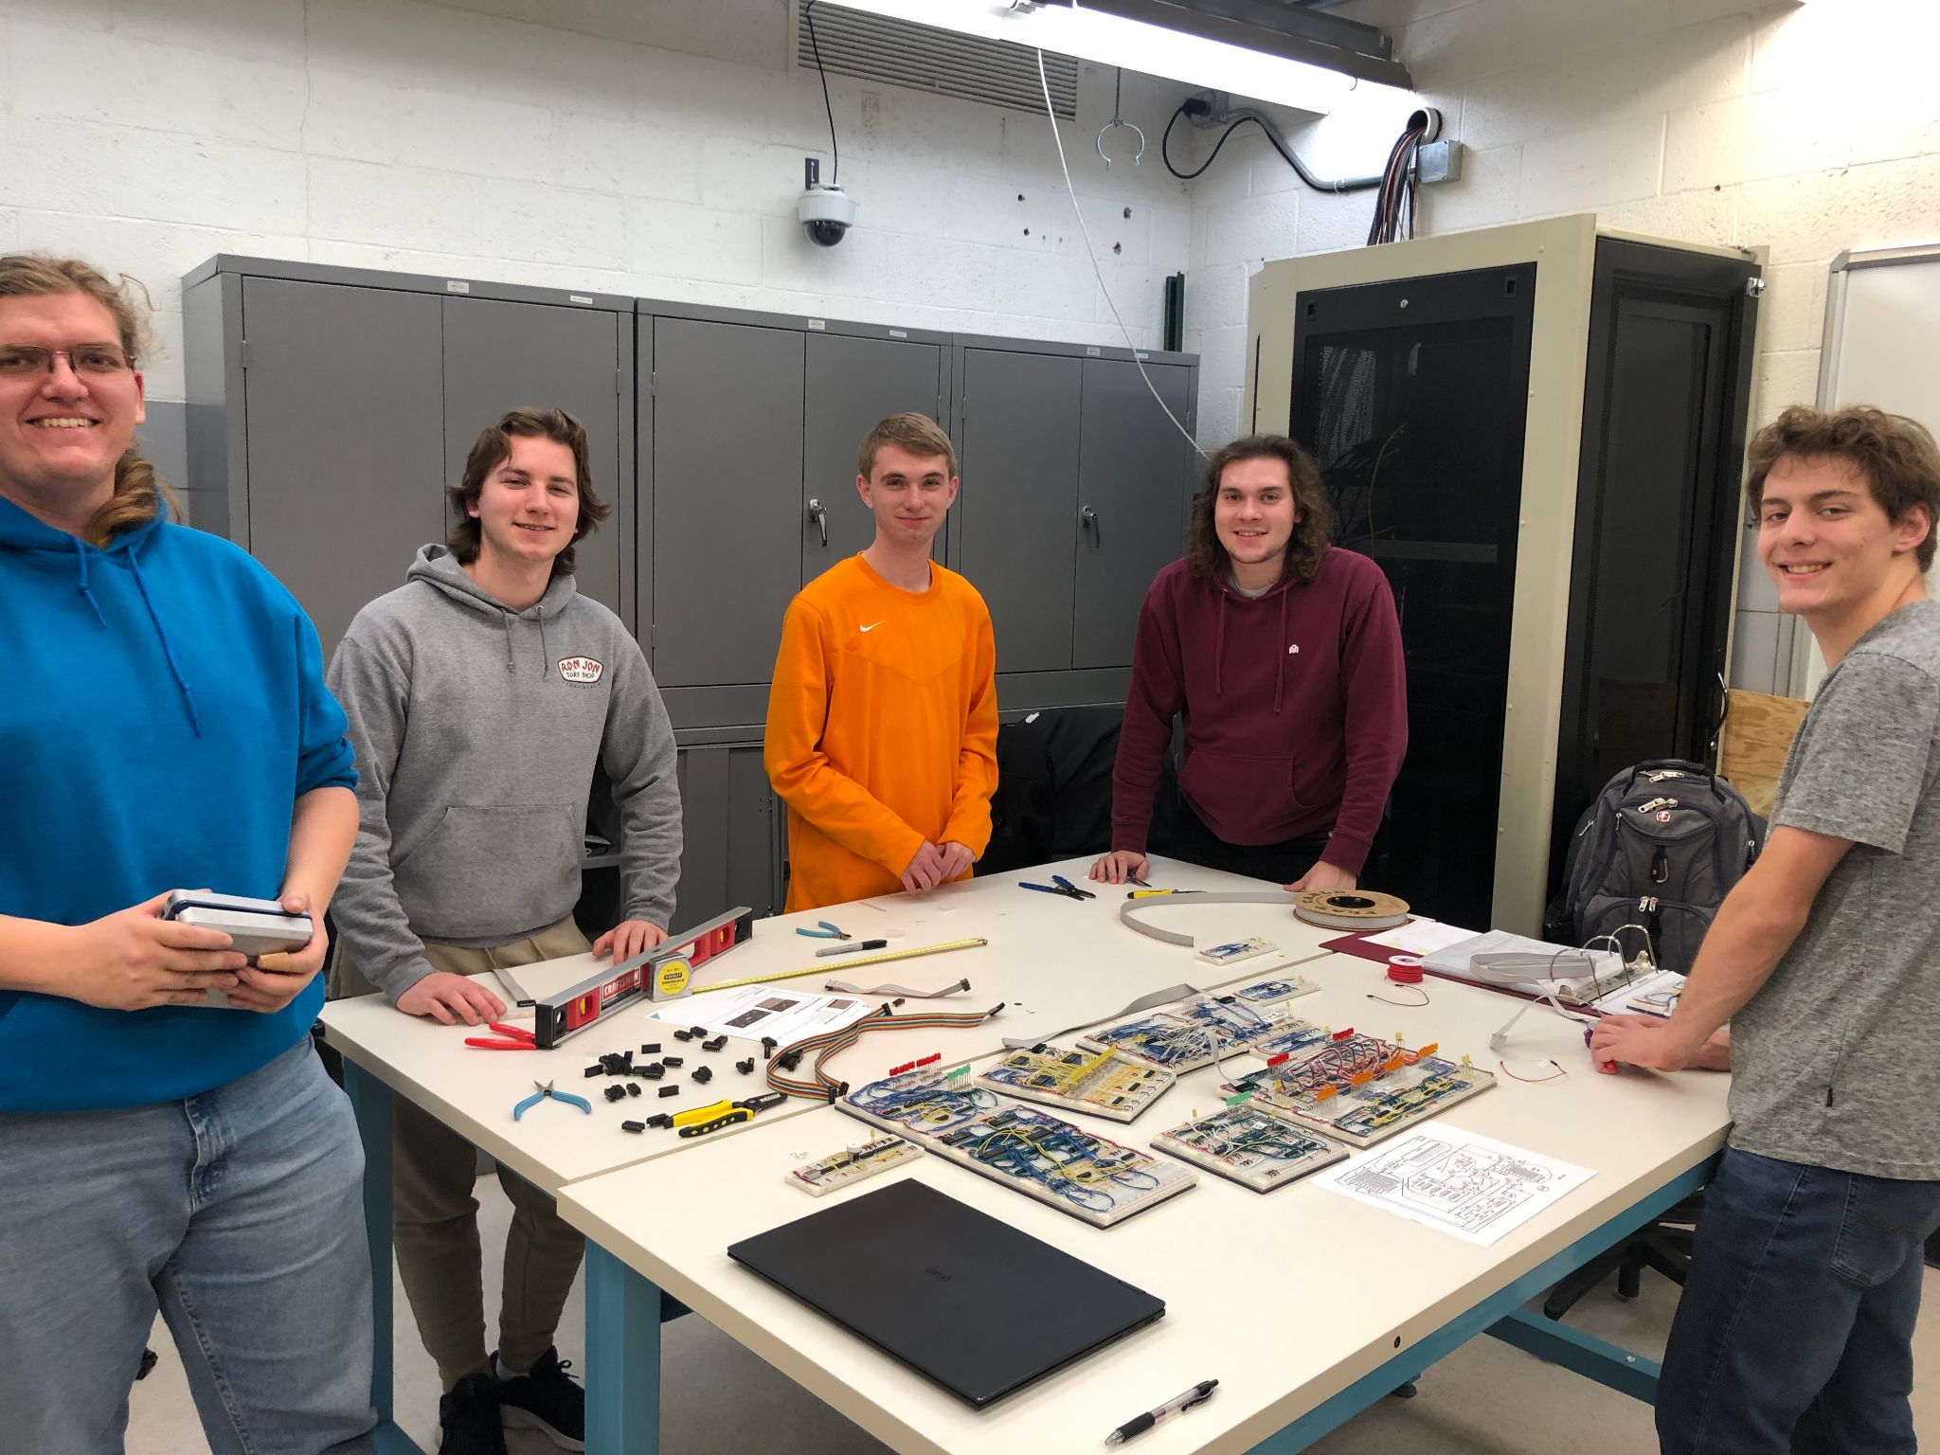
Breadboard Implementation
It works!
Only draws 0.5A max at 5V
We should continue our efforts
Notes:
[Daryl]
Put circles over a static image and relate to

Slide 50
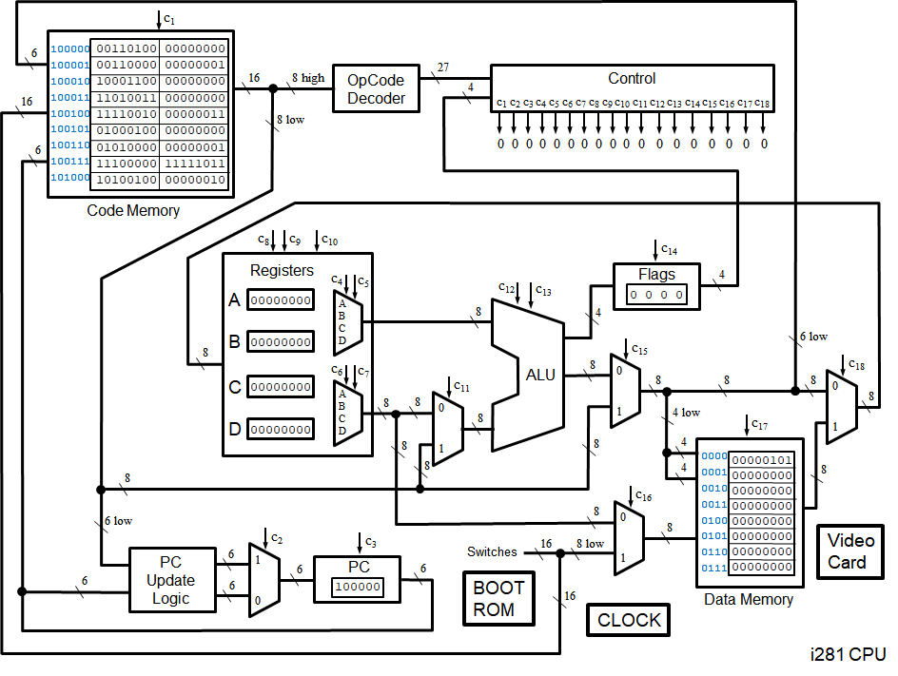
Design Complexity
Breadboards and Wires
Hardware Design/Constraints
Limited By Breadboards
Wiring Complexity
Educational Emphasis
Obtainable Parts
Available parts
Notes:
[Grant]
Created on breadboards, each component needs to be manually wired
Complex design, Lots of parts in common with most processors like RAM/ROM
Constraints: Limited by the breadboards, Wiring Complexity, Teaching tool
Every module constructed with obtainable parts
We made sure every component had a use in the overarching design
reference requirements for obsolete parts and hardware design/constraints -> flush out idea more

Slide 51
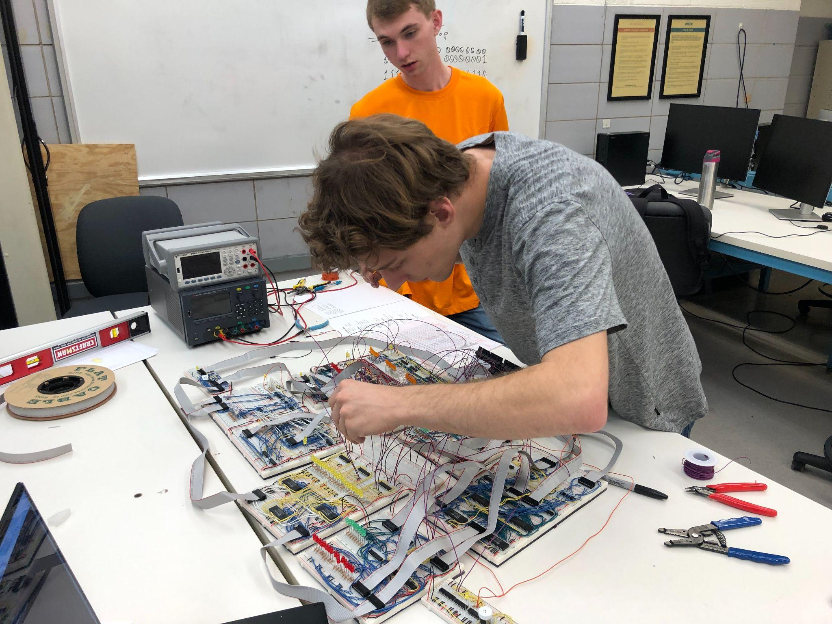
Design Iterations
i281 CPU Simulation and FPGA Design
FPGA Design + Our Design Decisions
Fixed Errors From Debugging & Redesigns
Notes:
CPU started completely emulated, online simulator available, Altera Board for Hardware
Bridge the gap between online and altera
Took from altera and Added our own ideas
Made minor adjustments along the way while designing

Slide 52
Project Plan
Risks
Receiving damaged components/breaking components
Shipping Times and Availability
Physical Labor of Implementation
Risk Mitigation
Ordering more chips than are needed
Ordering early and often
Creating schematics and other documentation to assist work
Notes:
[Grant] -> we order more chips than needed in the event that we get a dud chip, we burn one out during building/testing, or if we misplace/lose a chip. This mitigates our risk because one of those events shouldn’t impact our schedule or build times.
RISK: Parts being damaged, dud parts, Breaking our parts
MITIGATION: ORDERED MORE PARTS AHEAD OF TIME TO AVOID ISSUE
Risk: Lots of components needed take weeks to arrive, possibly derailing the project’s schedule
Mitigation: Had shopping list that I would send to the ETG well in advance to ensure we would have everything when we needed it
Risk: Human error and slow pace of the implementation
Mitigation: Schematics were made prior to implementation to streamline the process

Slide 53
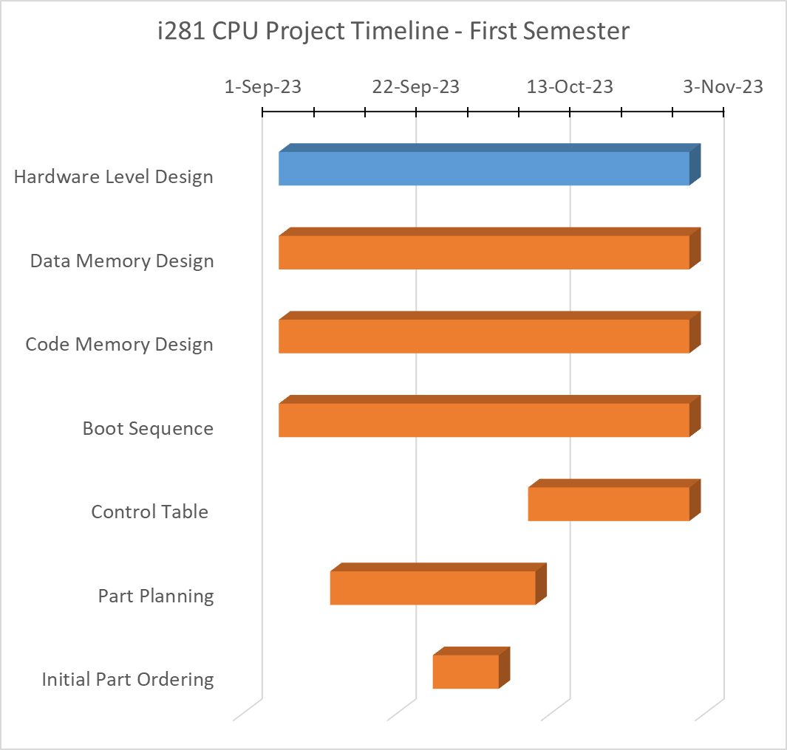
Project Schedule
First Semester
First Metric
Initial Designs
First Milestone
Hardware Level Design
Notes:
[Logan] We planned our workload throughout the semesters with a gantt chart. The first semester has a focus on breadboards. This required us to start with understanding and adapting the design to a physical level. We used the simulated i218 as a the base through these stage. After getting the design worked out we started to working on building the breadboard protype, our second focus for the semester.
Two Metrics
Design
Breadboard (BB)
Two Milestones
Hardware Level Design
Breadboard Implementation

Slide 54
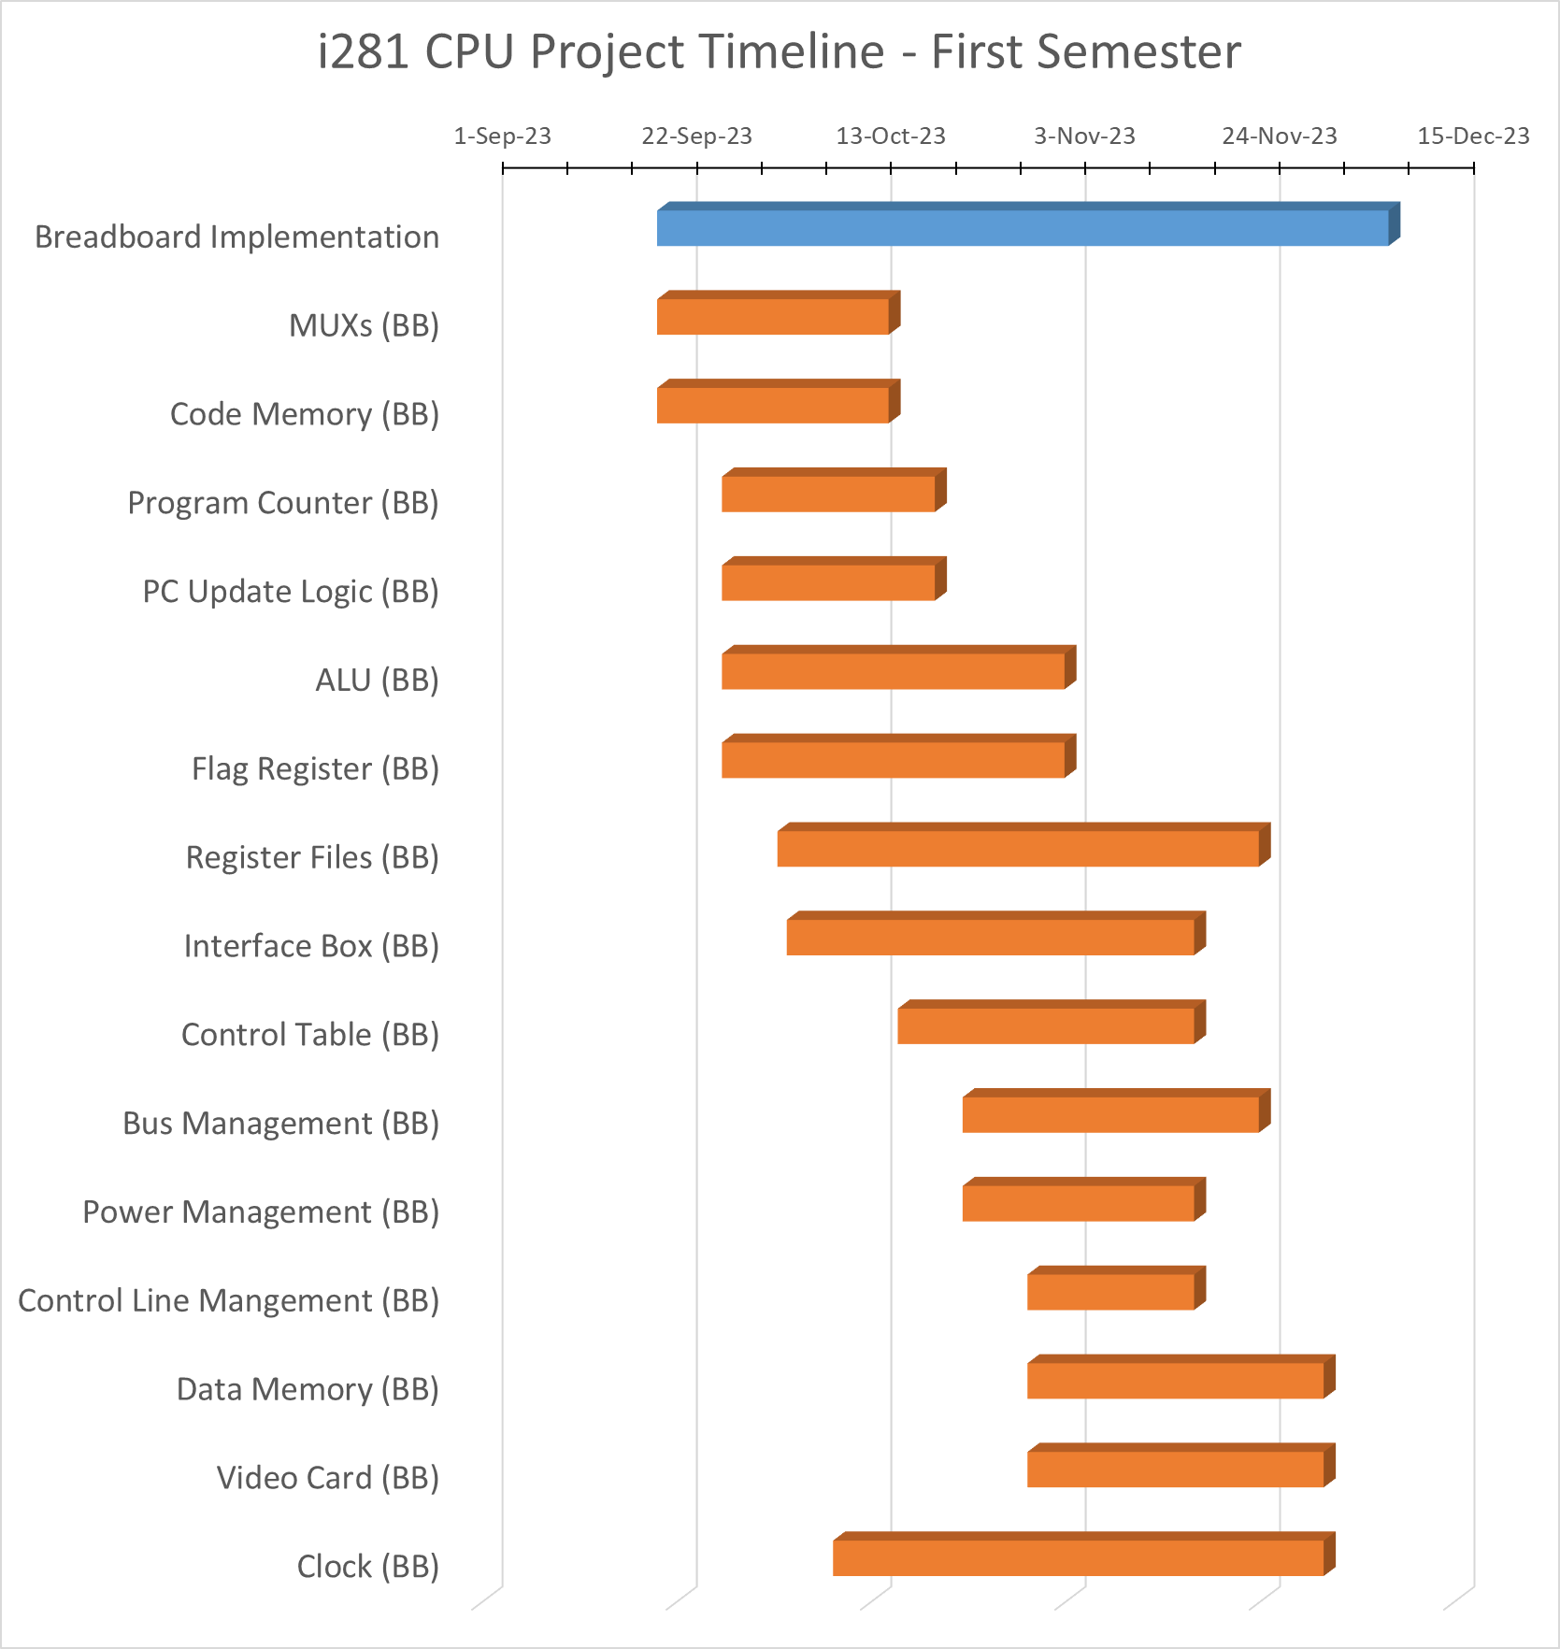
Project Schedule
First Semester
Second Metric
Breadboards (BB)
Second Milestone
Breadboard Implementation
Notes:
[Logan] We planned our workload throughout the semesters with a gantt chart. The first semester has a focus on breadboards. This required us to start with understanding and adapting the design to a physical level. We used the simulated i218 as a the base through these stage. After getting the design worked out we started to working on building the breadboard protype, our second focus for the semester.
Two Metrics
Design
Breadboard (BB)
Two Milestones
Hardware Level Design
Breadboard Implementation

Slide 55
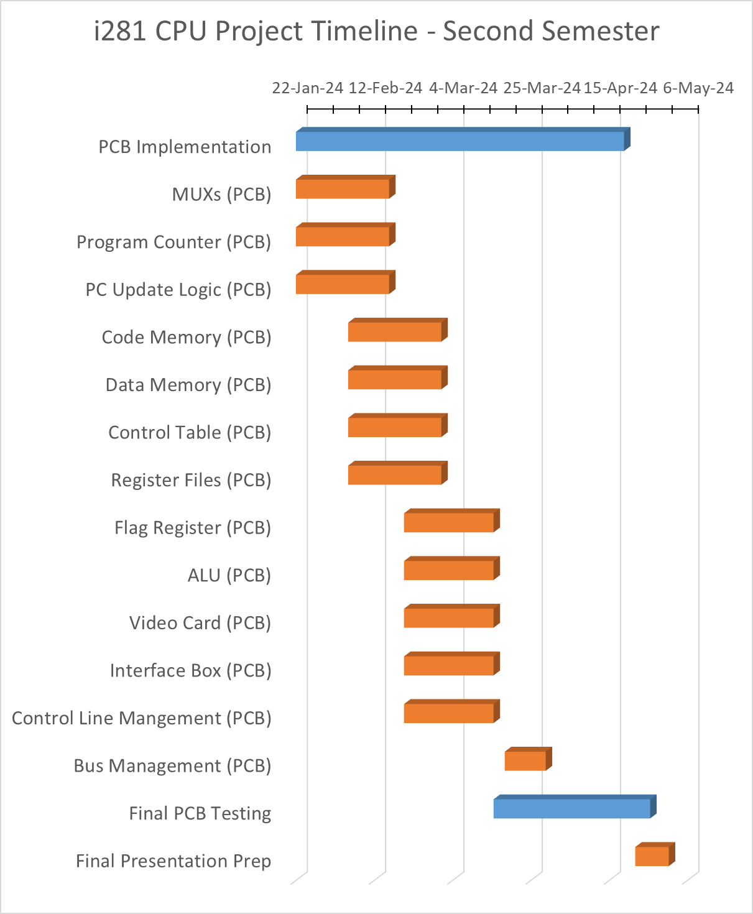
Project Schedule
Second Semester
Metric
Printed Circuit Board (PCB)
Milestones
PCB Implementation
Final PCB Testing
Notes:
[Logan] The second semester with have a focus on the PCB implementation. We will take the designed and experience from the physical breadboard i281 CPU and update to a PCB version. This will allow us to order printed circuits boards and test our final version of the CPU.
Goals: Finish and Fully Test the PCB design and fulfill all requirements.

Slide 56
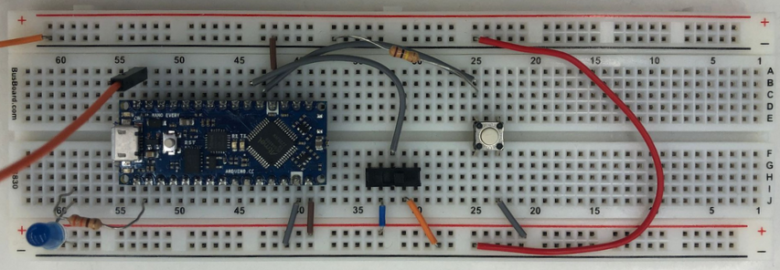
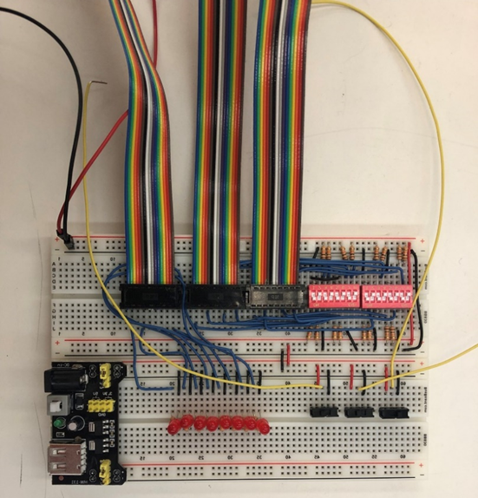
Test Plan
Physical Testing
Testing Rigs
Clock using Arduino Nano Every
Unit Testing
Each island must work by itself before testing the whole system
Notes:
[Logan]
For our test plan, a physical testing rig was designed and developed by Gavin to allow for us to accomplish unit and acceptance testing throughout implementation. This testing rig can be seen in the figure above. It is comprised of two 8-bit DIP switches, two transmit cables, one receive cable, and a visualization of the receive cable. Early in testing, this was monumental in aiding our capabilities in testing small 8-bit multiplexer boards.
Something that was also early in the breadboard implementation was our clock module. The clock module built from a 2MHz crystal oscillator wasn’t implemented until near the end of the semester. As a supplemental module, and to test different clock speeds easier, an Arduino Nano microcontroller was used to mimic the clock module and support stepping through a clock pulse manually. This propelled our testing in early stages of the project by reducing our concern about incorrect clock speeds and waiting for part orders.

Slide 57
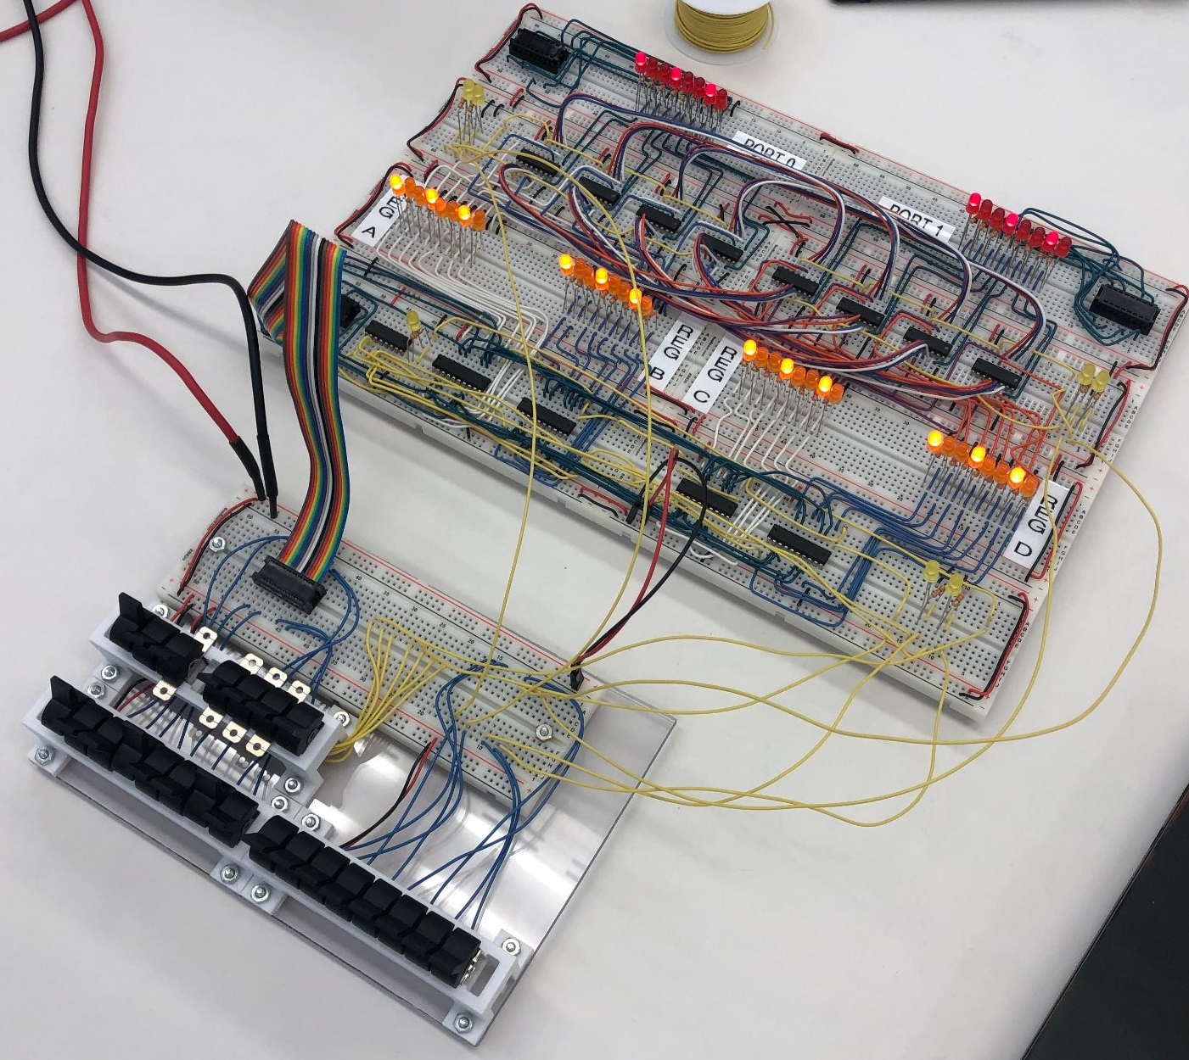
Test Plan
Acceptance Testing
Testing electrical properties
Ex. short circuits
Integration Testing
Entire system testing & running program
Interface Testing
Interface panel designed with basic input and control switches
Notes:
[Braxton]
video showed the two instruction program that we tested the system with
NOTE: Add something about how unit/acceptance testing helps us validate our requirements. Or testing in general.

Slide 58
Conclusions
Current Schedule
Data Memory with Video Card and Boot ROM components unfinished
Implementation completed but lacking a grounded setup
Next Semester
PCB Design
Missing components breadboard implementations
Notes:
[Daryl]
To conclude our project presentation, there are two more things to cover. Considering where we are at in our schedule, there are two CPU components that we have not developed yet which were planned. Those components are the Data Memory (with video card) and Boot ROM. Both of these components will be designed and developed during the start of the second semester. Further, our implementation was complete, barring the missing components; however, we were unable to finish making a grounded, permanent setup before the end of the semester. Like the components, this will also be designed and developed right after Winter break which will allow us to move on to the next semester schedule.
Next semester we plan beginning the PCB design process. As we have developed schematics over the course of this semester, the remaining work is to perform PCB routing and ship our files off to a manufacturer. Once we gather our parts, we will begin inspection, assembly, and testing.

Slide 59
Contributions
Daryl Damman: Team Lead, Register Files Design, Breadboard Implementation, Documentation, Testing
Logan Lee: Clock and Control Table Design, Breadboard Implementation, Documentation, Testing
Grant Nordling: Program Counter and Control Table Design, Part Ordering, Documentation
Braxton Rokos: ALU and Program Counter Logic Design, Documentation, Breadboard Implementation, Testing
Gavin Tersteeg: Code Memory, Input Switches, and Debug Logic Design, Documentation, Breadboard Implementation, Testing
Notes:
[Daryl]
I won’t read off our semester’s contributions for the project but you can find the specific details on the slide above, design document, in the downloadable slide deck off our project website. Special thanks to our client Dr. Stoytchev for meeting with us every week to understand the requirements, design, and other technical details of the project and encouraging us throughout development.

Slide 61
THE END

Slide 62
Backup Slides

Slide 63
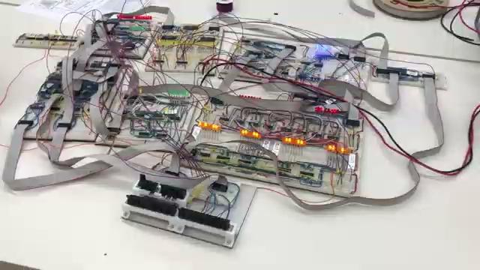
Breadboard Implementation
Notes:
[Daryl]
Put circles over a static image and relate to

Slide 64
Engineering Standards
Notes:
[Grant] Functional, qualitative, quantitative, and constraints
Were able to separate them and make them more concrete
NOTES: crop the image, spend only ~10 seconds here.
Need a new slide regarding our IEEE standards in our design document.
Put in design complexity: chip selection.

Slide 65
Breadboard Implementation
Decoder
ALU
MUX
Clock
MUX
Code Memory
Program Counter
Registers
Switches

Slide 66
Bus Multiplexers
Notes:
[Daryl]
BREAK THIS SLIDE UP INTO TINY PIECES WITH FULL IMAGE. Diagram, schematic, then implementation.
Building upon the original diagram from the FPGA implementation, several components will be grouped together to simplify implementation and group functionally similar components together. There will be twelve independent components of the processor:
4 independent 8-bit multiplexers
These are the individual components that are not incorporated directly into a CPU component.
Data Memory (& Video Card)
Due to how closely the video card interacts with the data memory storage, the video card and data memory will be combined.
Code Memory
This will store both BIOS and active user or example program alongside a visualization of the instruction and current program address.
Instruction Decoder
Both the Opcode decoder and control component are merged into a single component: the instruction decoder. Rather than developing a large logical circuit, we can simplify the design by combining both of these components. This will be discussed during the design plan.
Arithmetic Logic Unit (ALU)
The flag register will be grouped with the ALU as the ALU must make changes to the flags register depending on the instruction executed.
Program Counter
The PC Update logic circuit and multiplexer will be absorbed directly into the Program Counter as they interact closely together.
Register File
The register file is one of the only components that was not merged with neighboring CPU components as it acts upon itself without needing to directly modify any other component.
Boot ROM
Due to how boot operations will occur in the final design, a separate dedicated ROM storage called Boot ROM is needed. This will remain near the interface panel (switches).
Clock
The clock module was never directly include in the original diagram but it is still needed in the final design. This will be an independent component that will map a clock pulse line between five different components.
Regardless of how we implement this project, through breadboards or PCBs, this is our final separation of function between components.

